Slide 1
Simulation Results of with and without parasitics for 50 ohm input resistance
TIME DOMAIN COMPARISONS
Comparison of input currents
Comparison of leg currents
Comparison of capacitor currents
Frequency DOMAIN COMPARISONS
Comparison of input currents
Comparison of leg currents
Comparison of capacitor currents

Slide 2
TIME DOMAIN COMPARISONS
Comparison of input currents
Comparison of leg currents
Comparison of capacitor currents

Slide 3
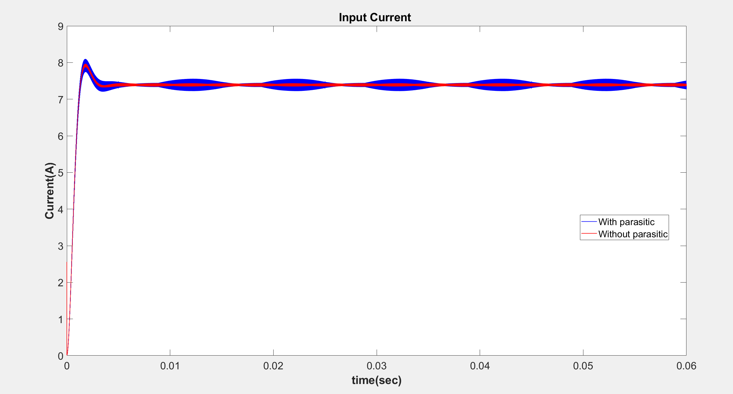

Slide 4
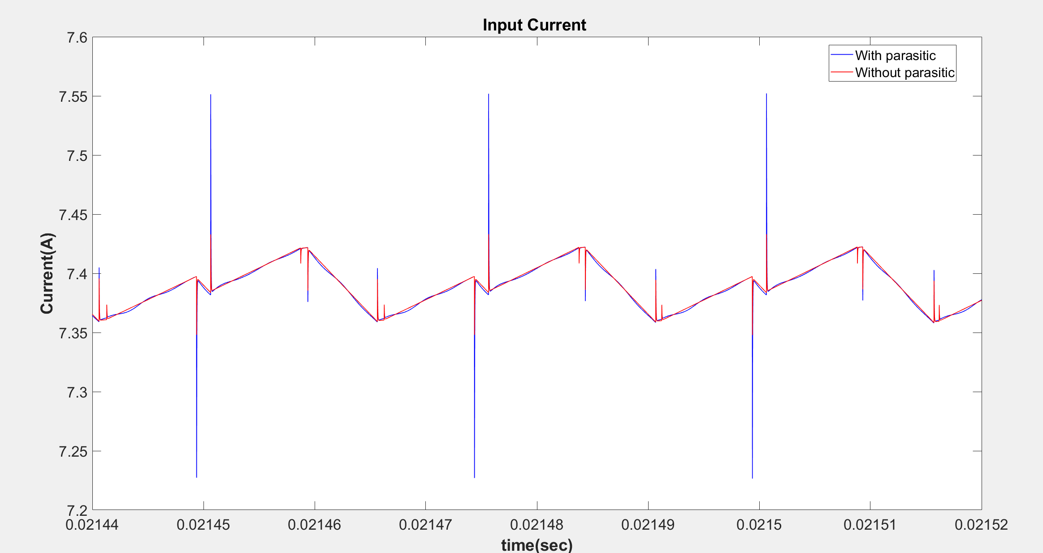

Slide 5
 | Input Current (Mean)
With Parasitic | 7.3198
Without Parasitic | 7.3204

Slide 6
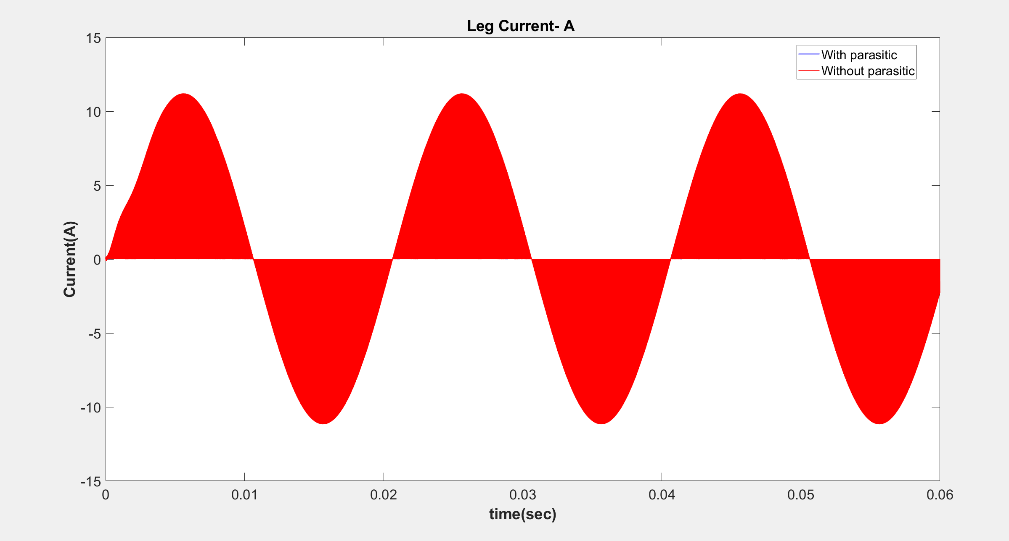

Slide 7
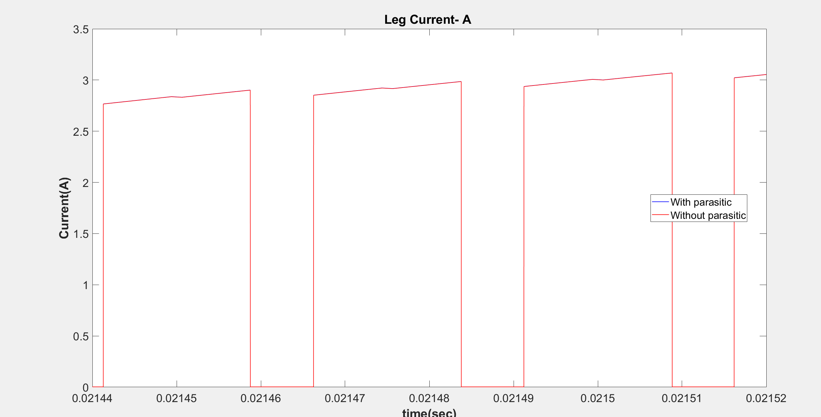

Slide 8
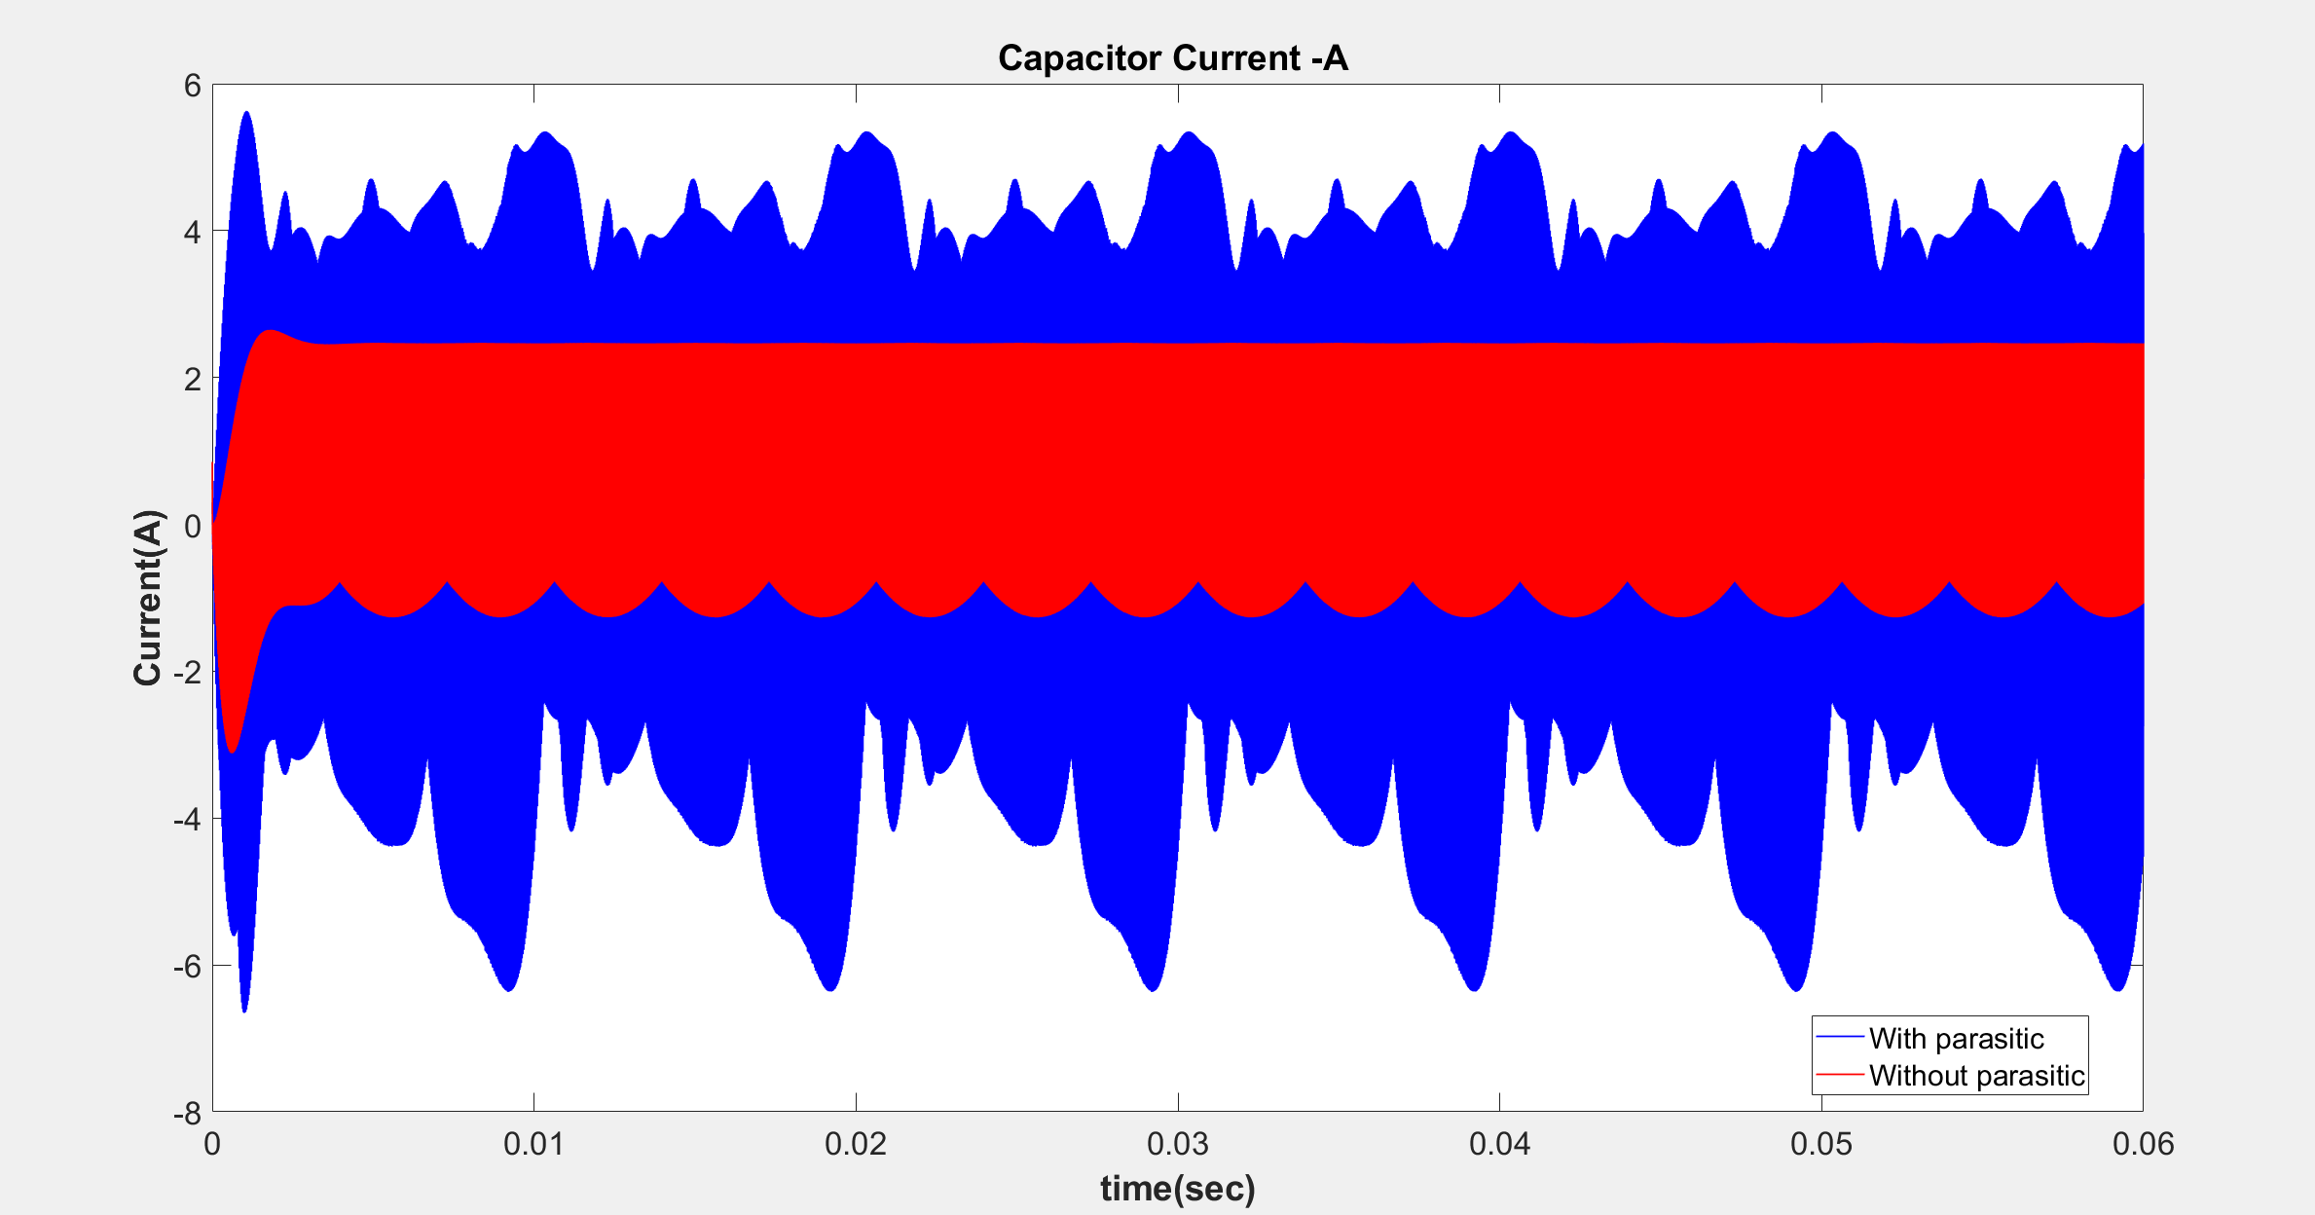

Slide 9
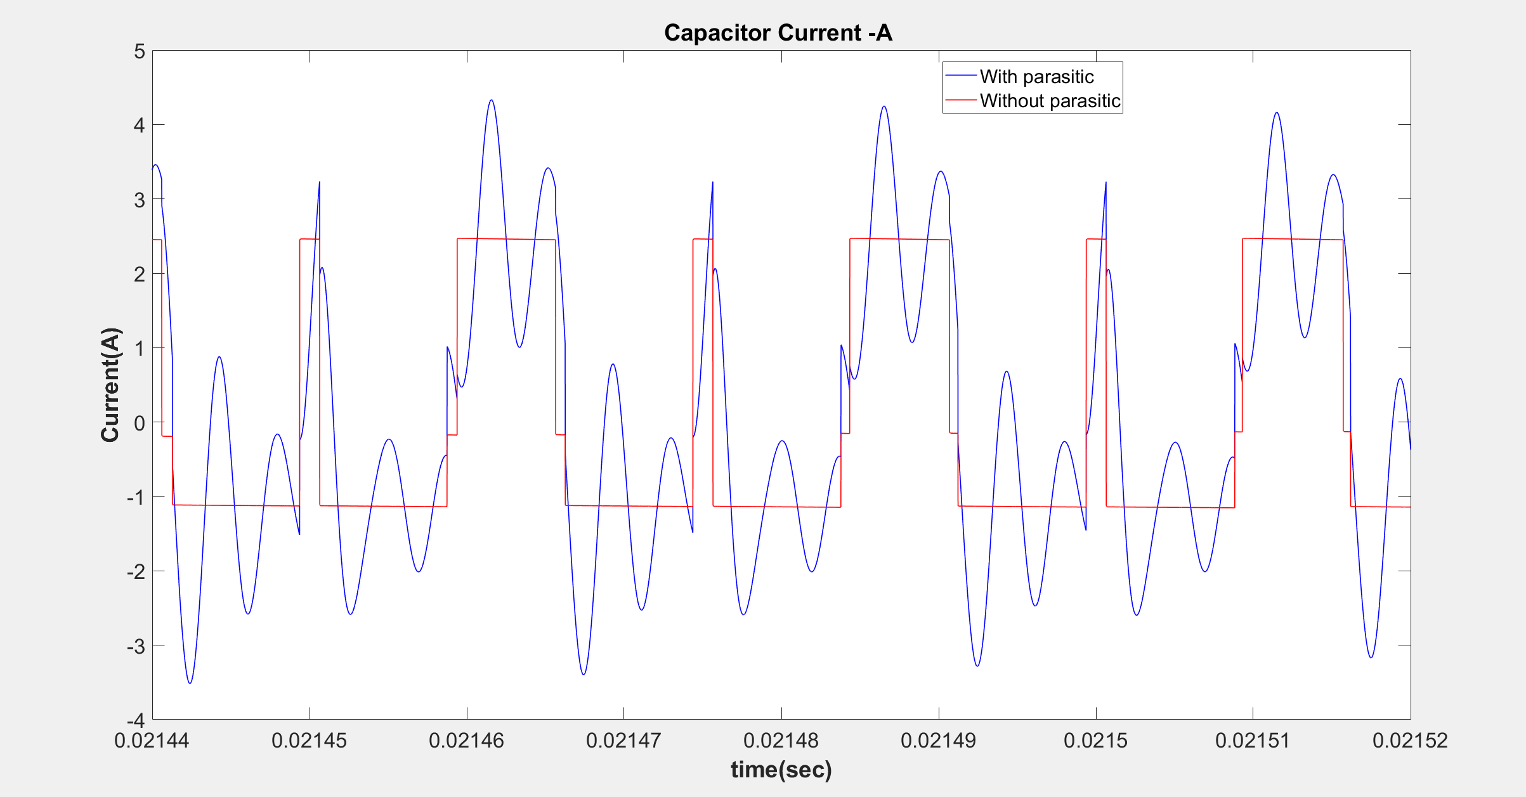

Slide 10
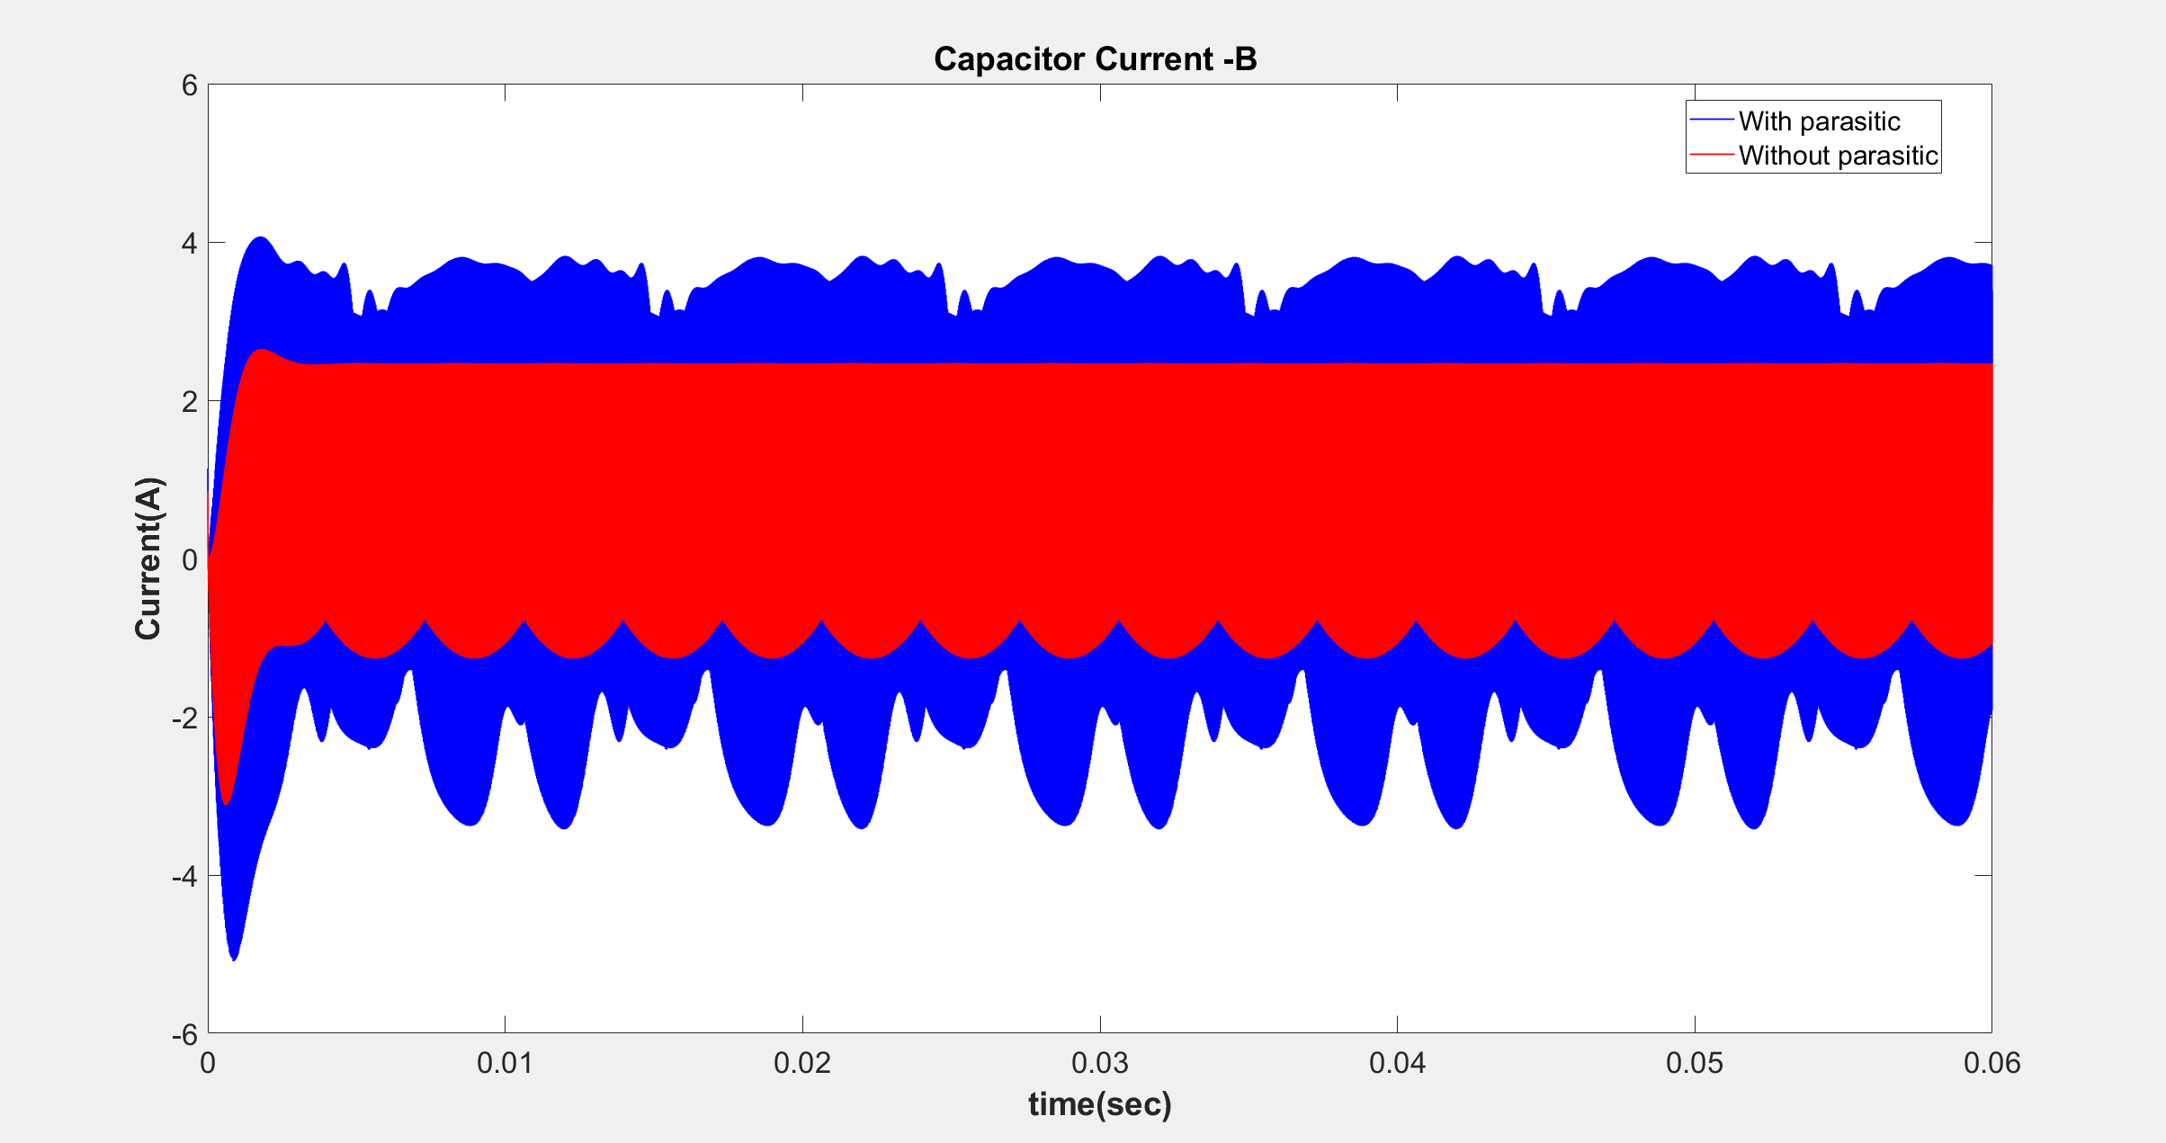

Slide 11
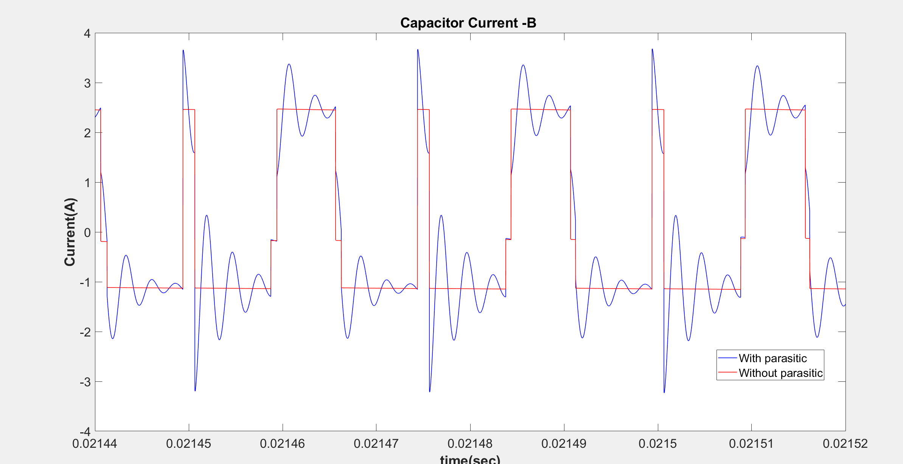

Slide 12
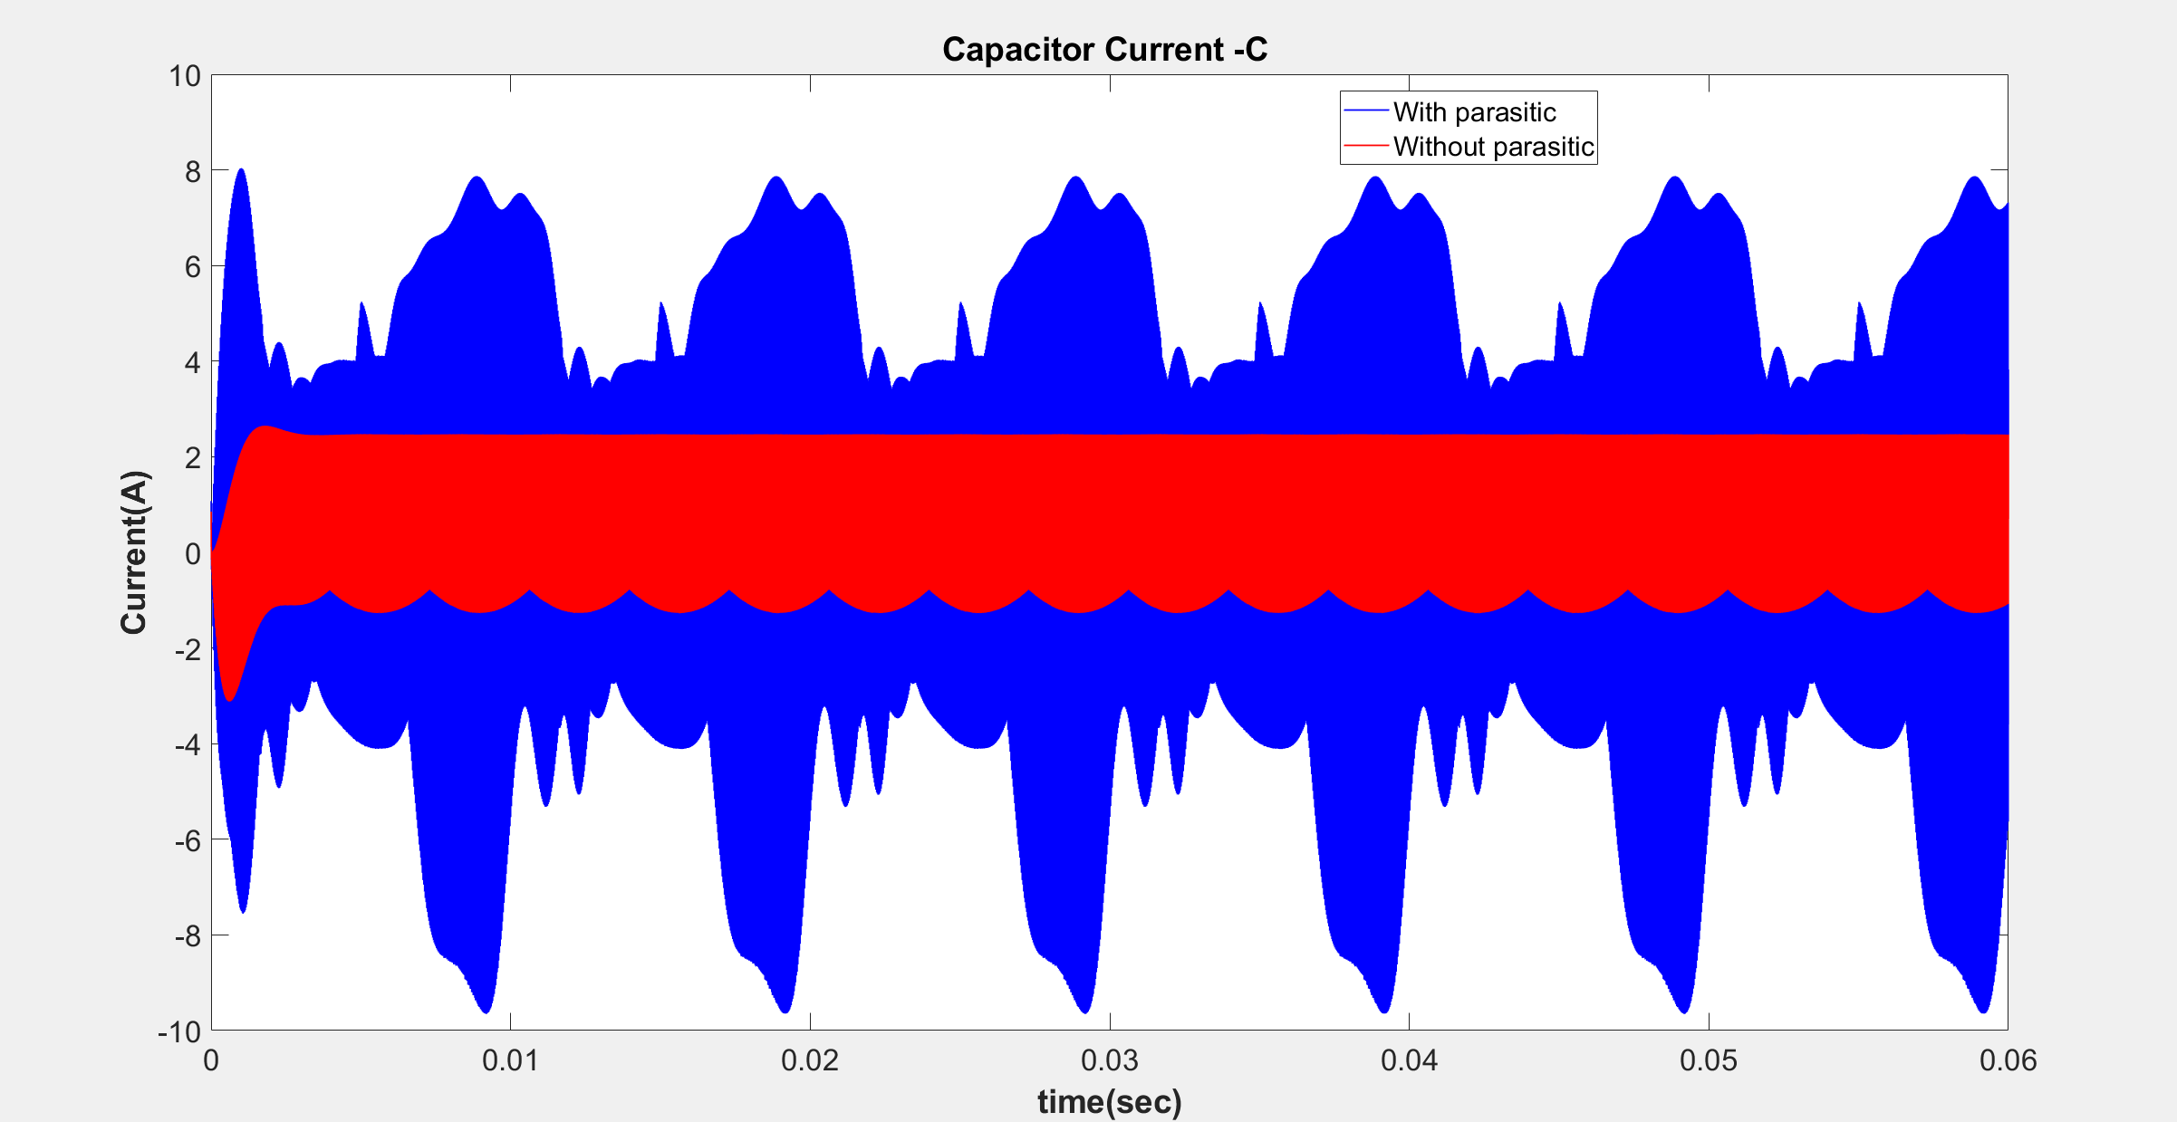

Slide 13
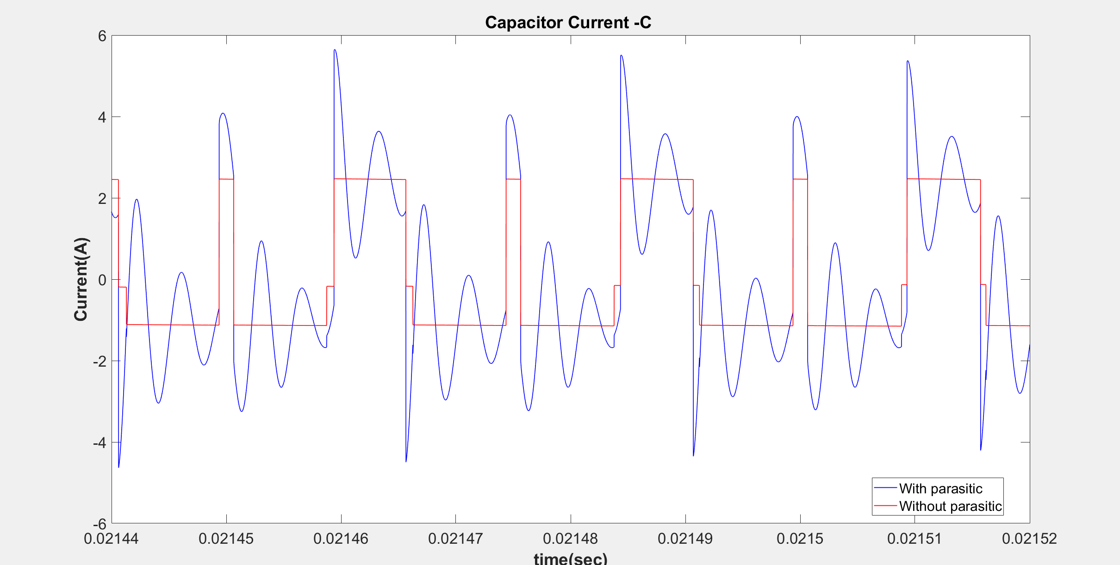

Slide 14
Frequency DOMAIN COMPARISONS
Comparison of input currents
Comparison of leg currents
Comparison of capacitor currents

Slide 15
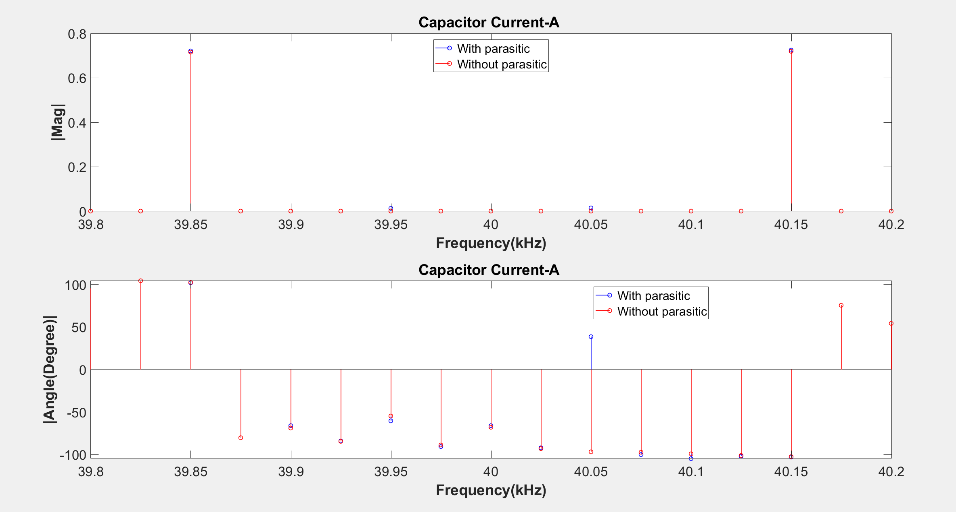

Slide 16
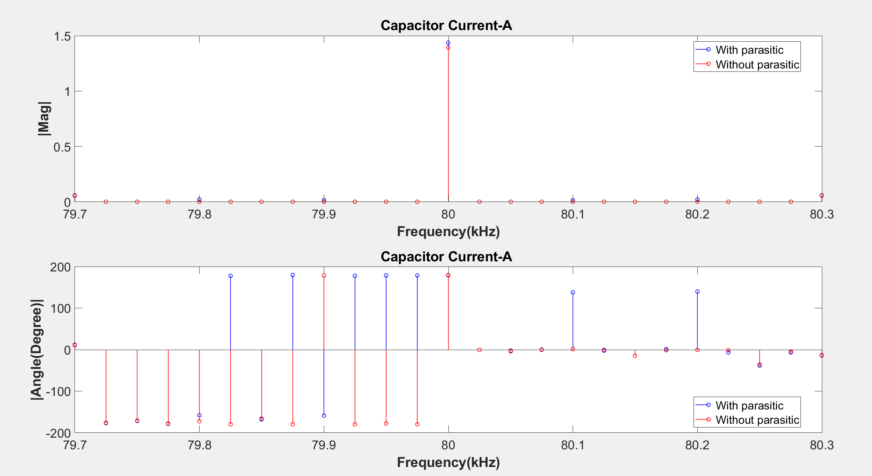

Slide 17
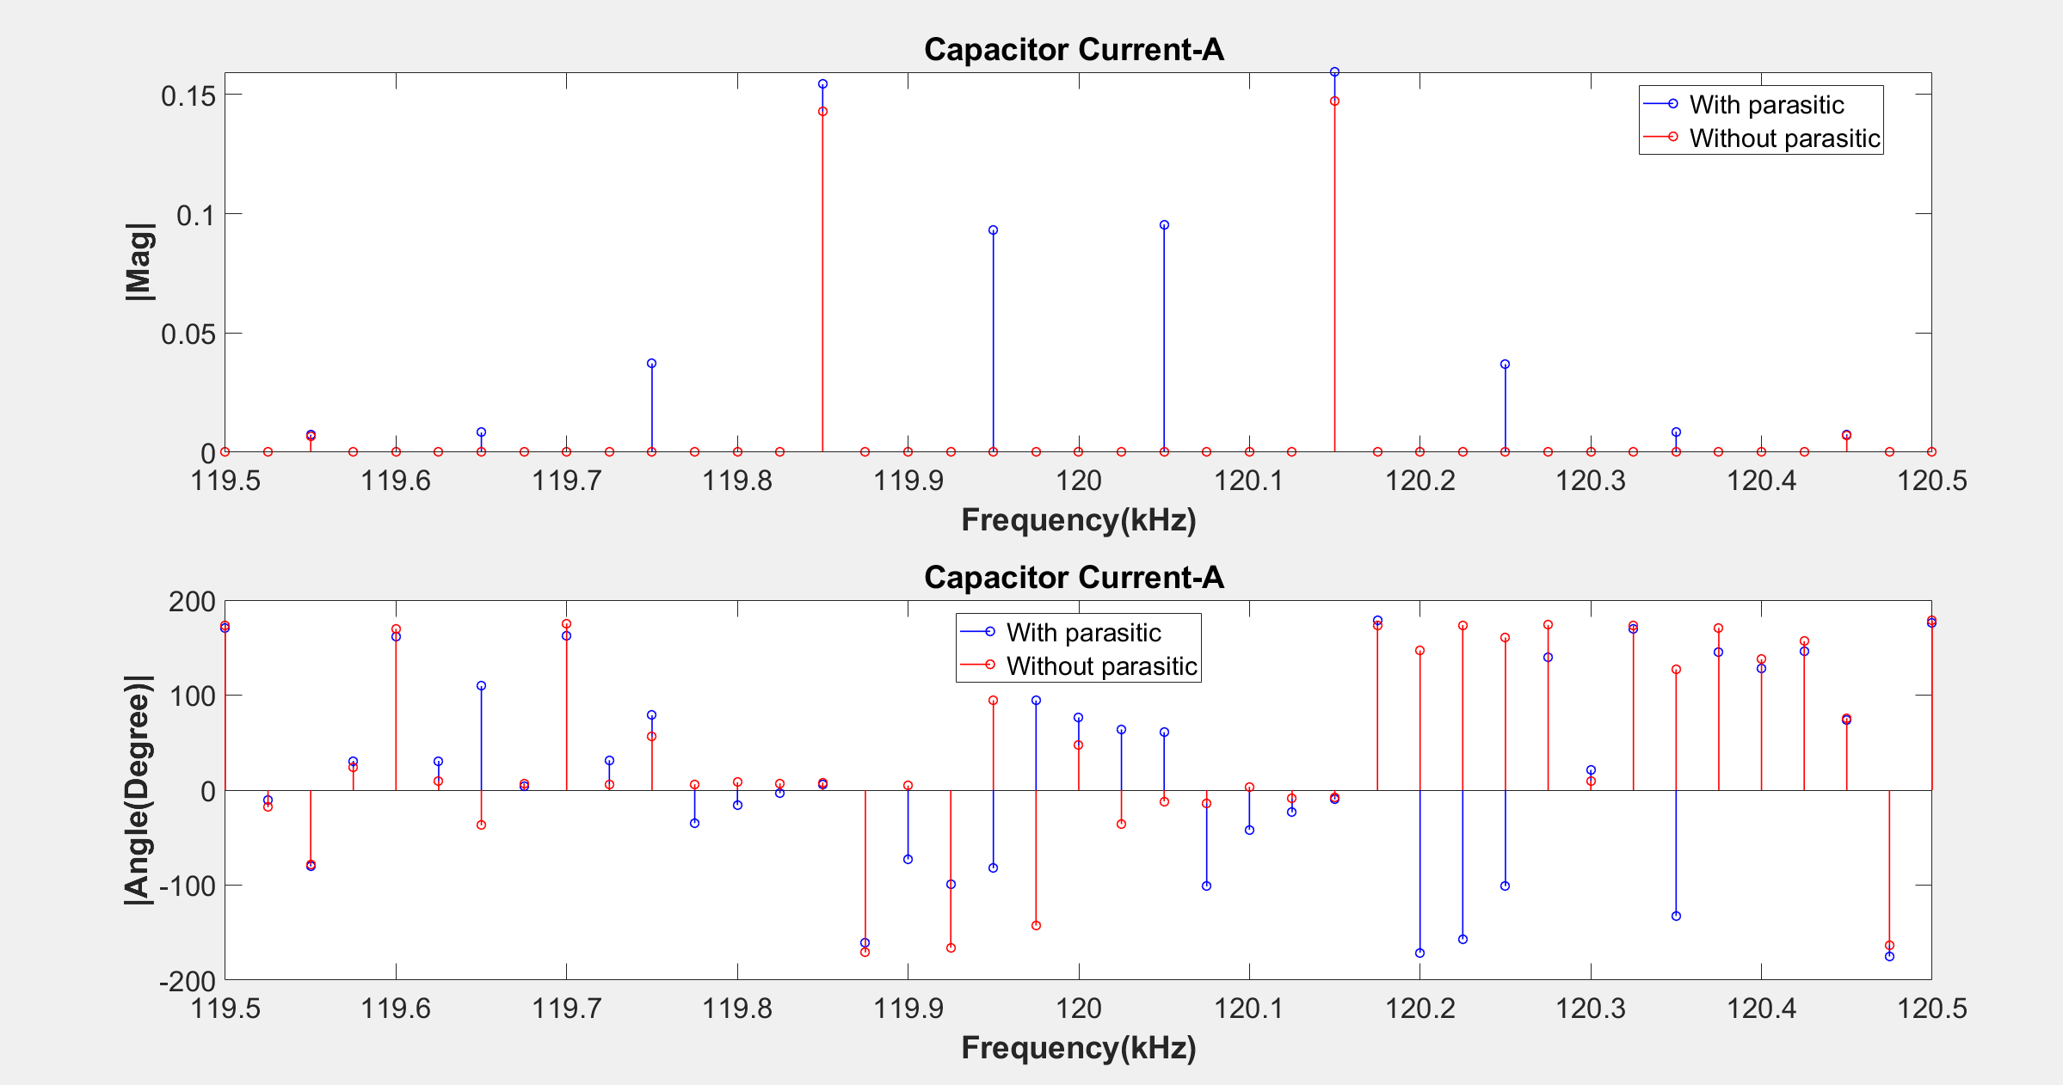

Slide 18
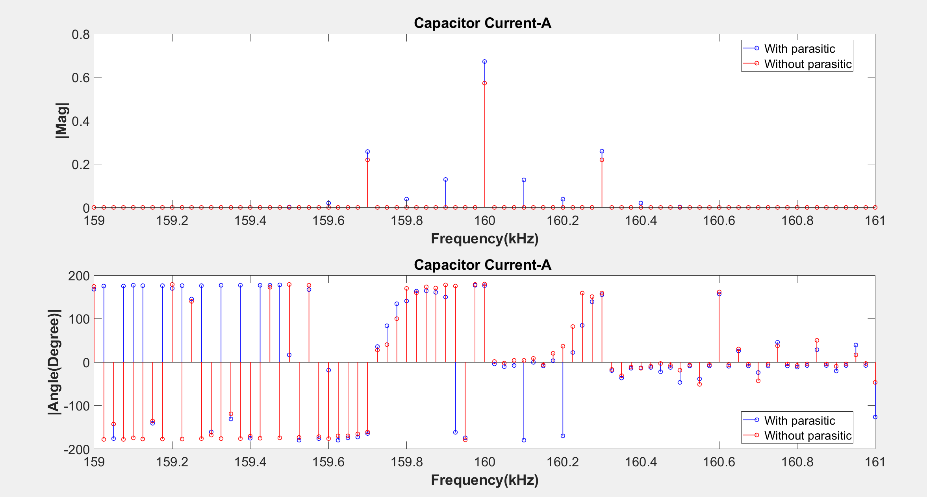

Slide 19
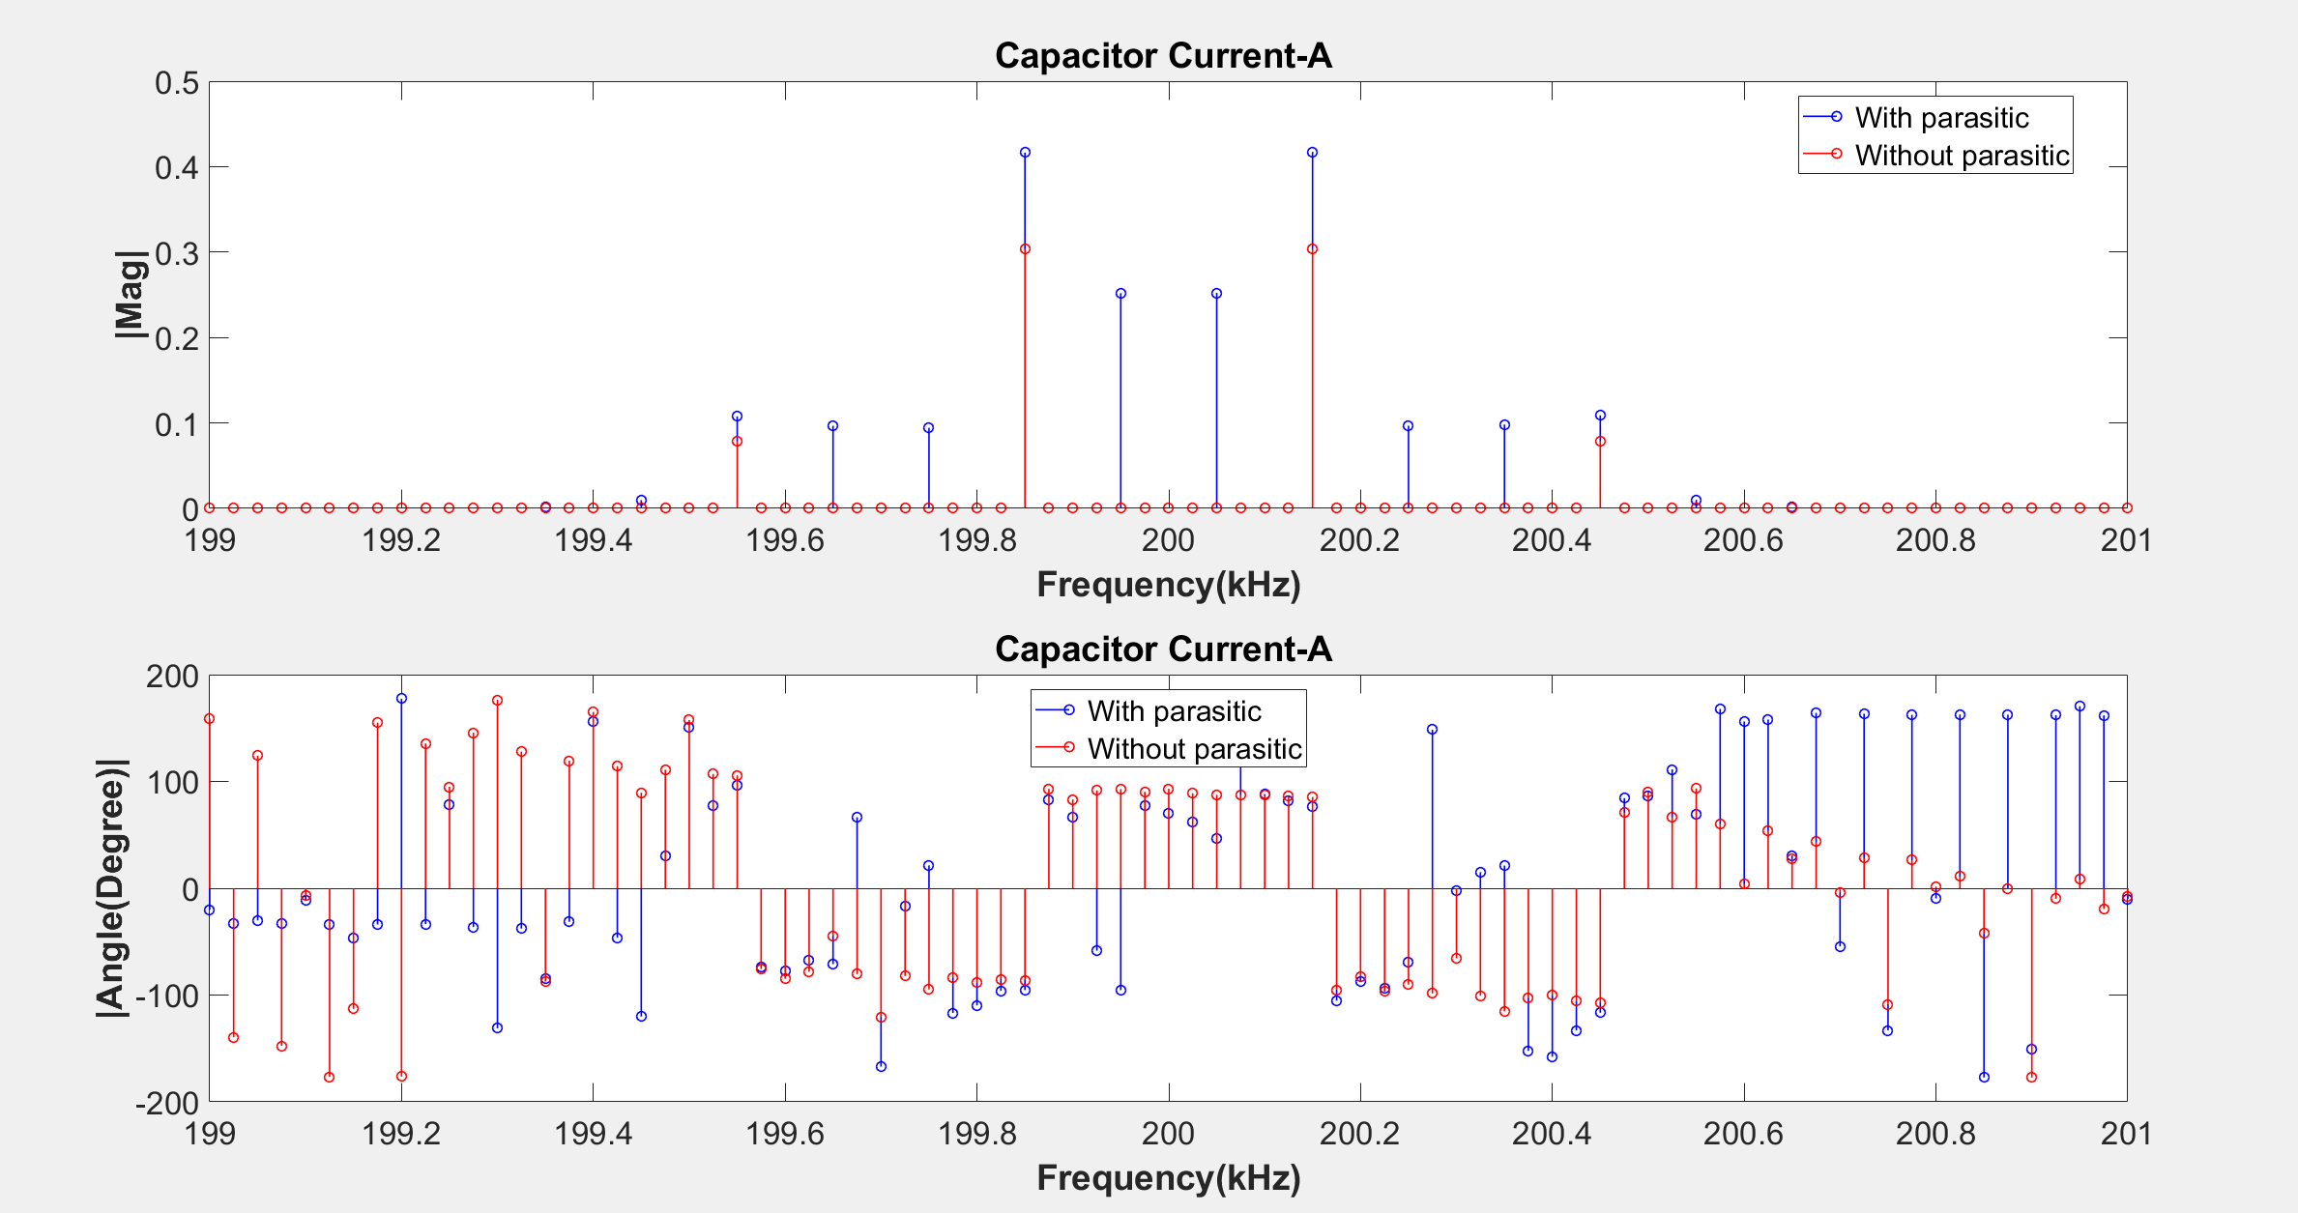

Slide 20
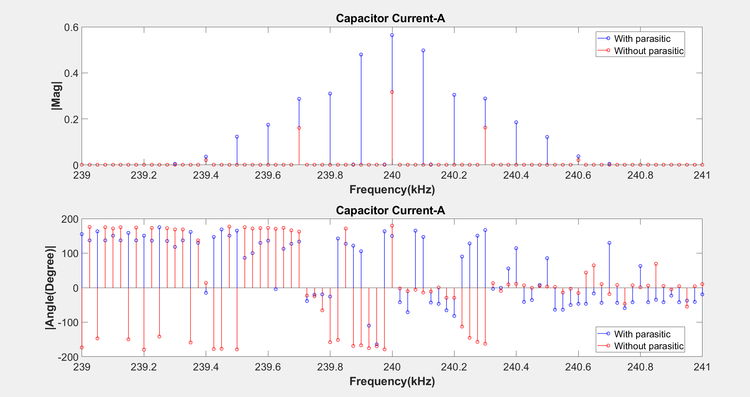

Slide 21
Simulation Results of with and without parasitics for 0.1 ohm input resistance
TIME DOMAIN COMPARISONS
Comparison of input currents
Comparison of leg currents
Comparison of capacitor currents
Frequency DOMAIN COMPARISONS
Comparison of input currents
Comparison of leg currents
Comparison of capacitor currents

Slide 22
TIME DOMAIN COMPARISONS
Comparison of input currents
Comparison of leg currents
Comparison of capacitor currents

Slide 23
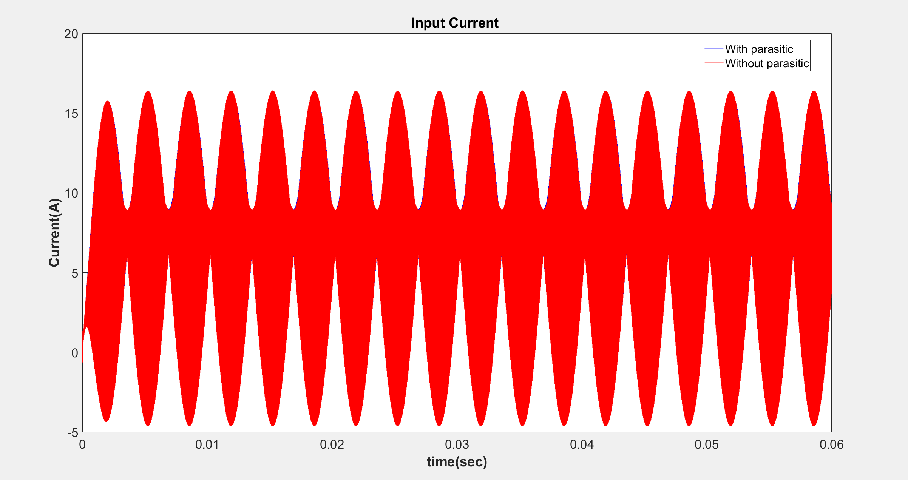

Slide 24
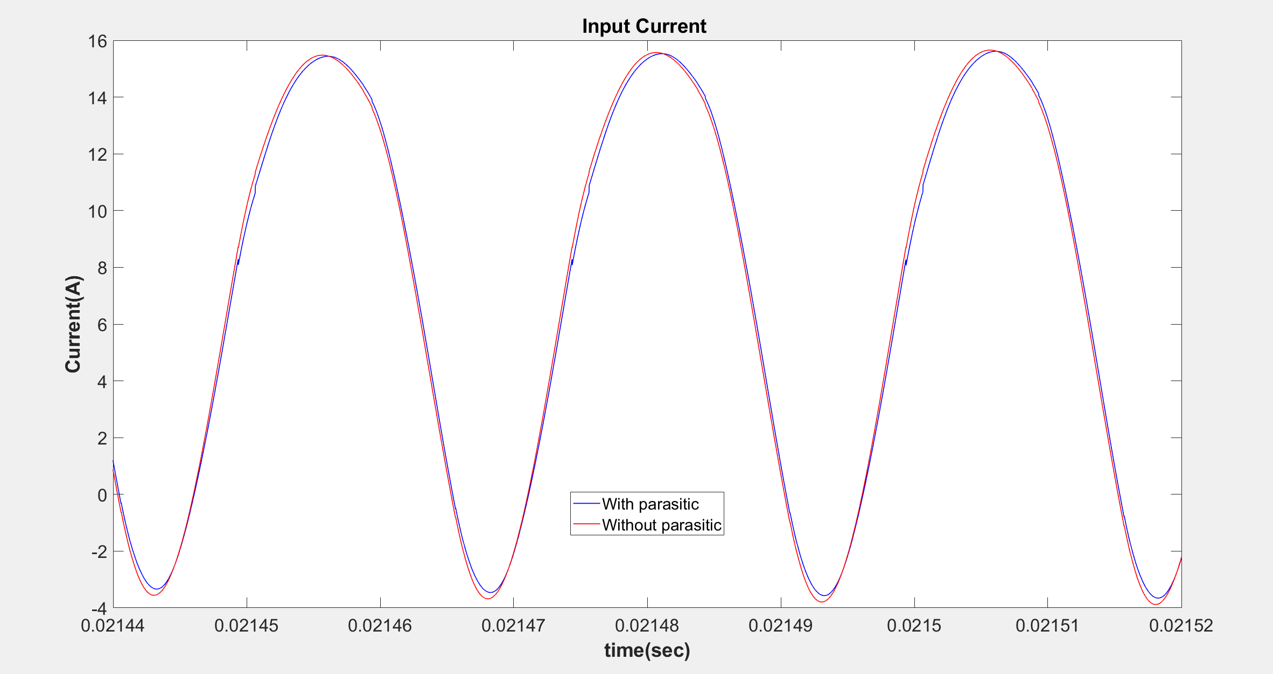

Slide 25
 | Input Current (Mean)
With Parasitic | 7.2831
Without Parasitic | 7.2844

Slide 26
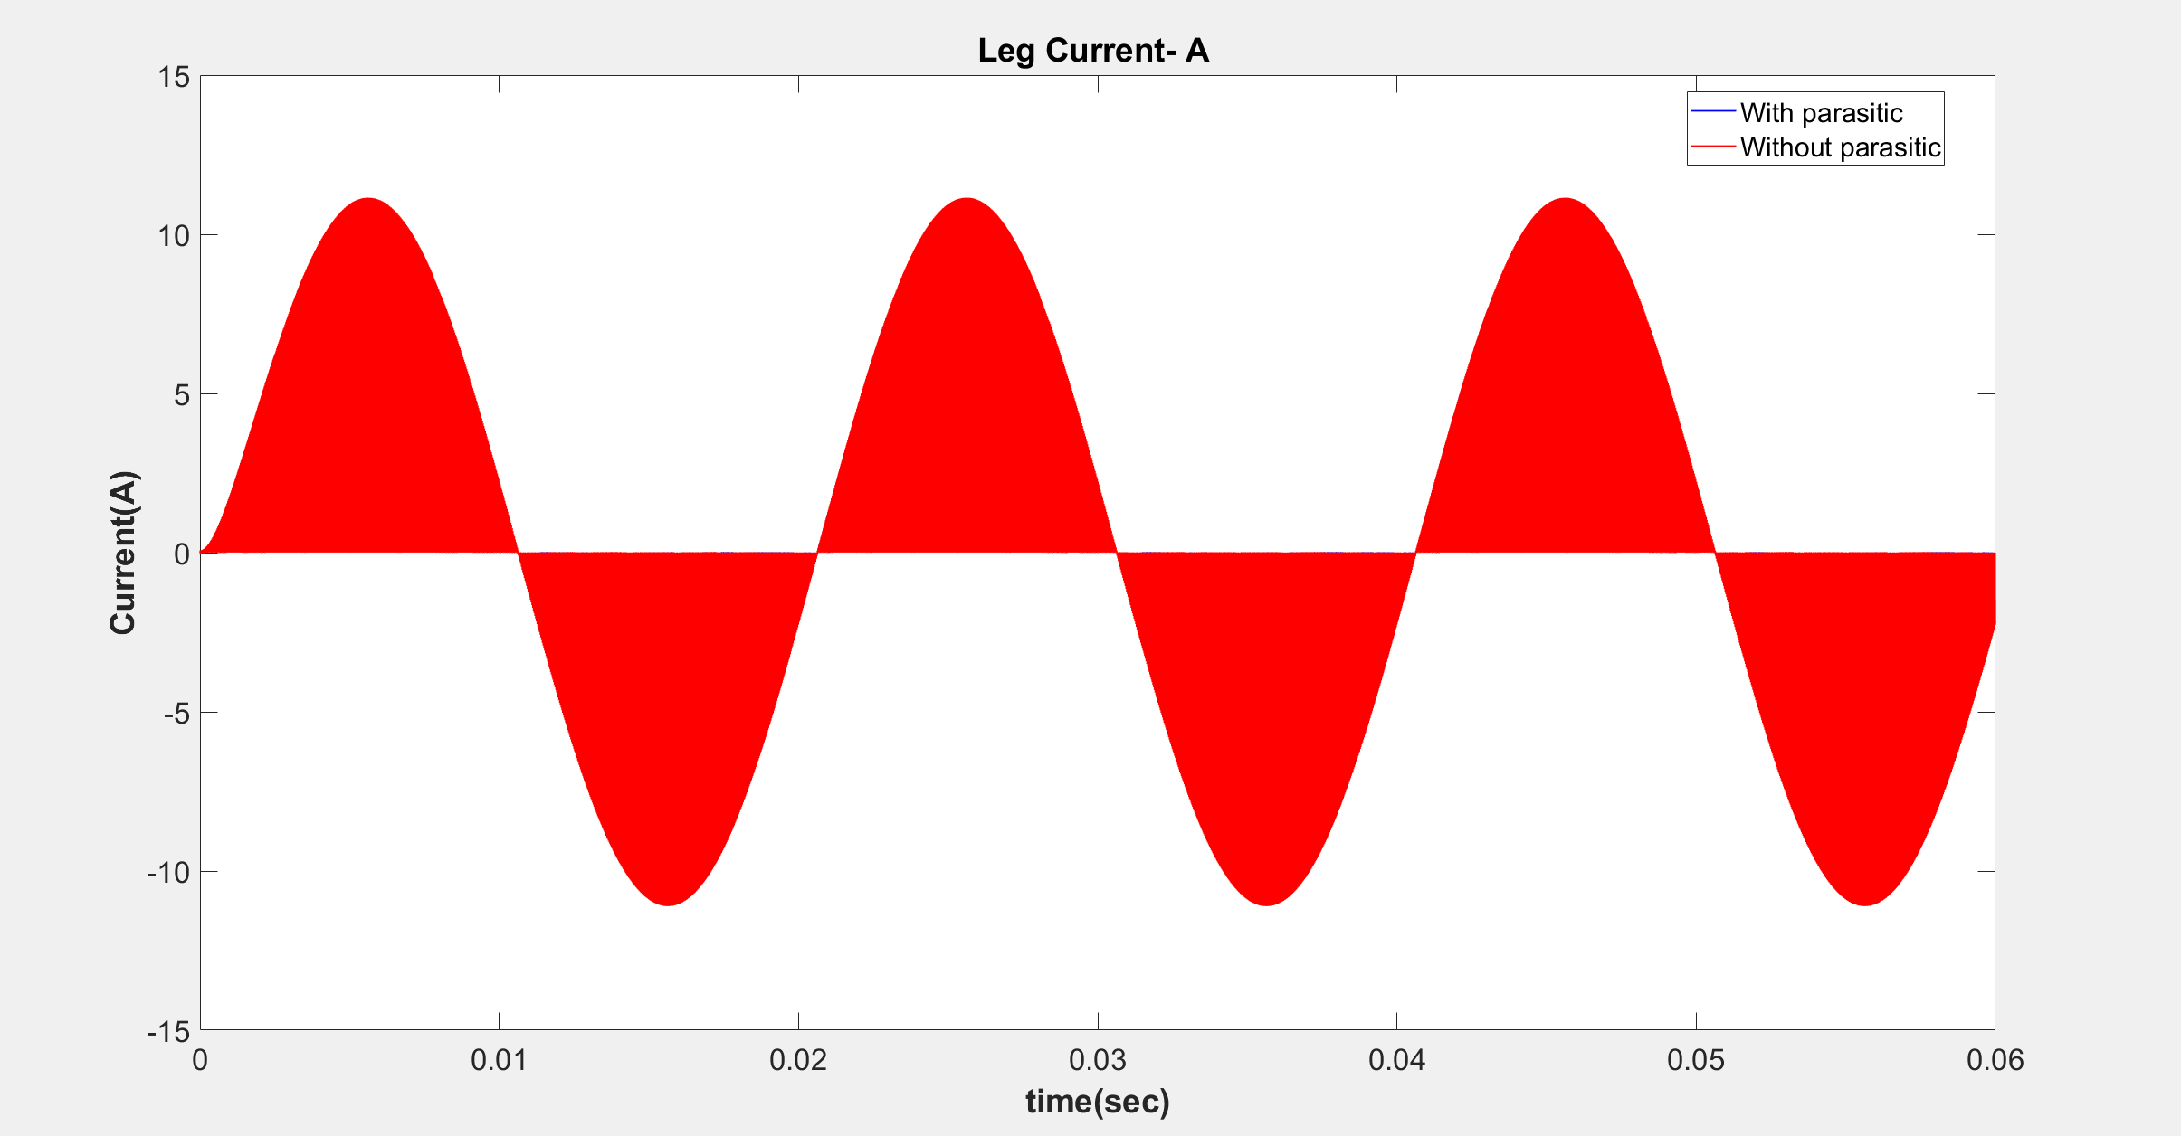

Slide 27
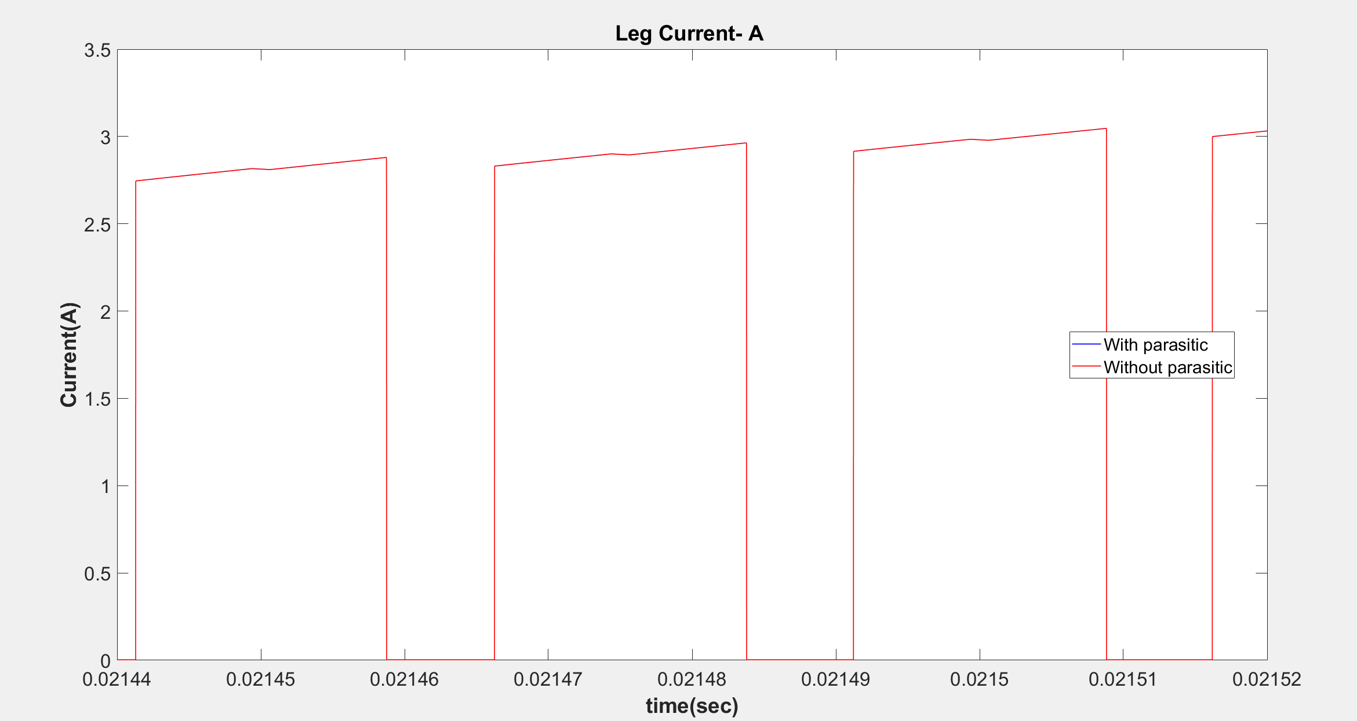

Slide 28
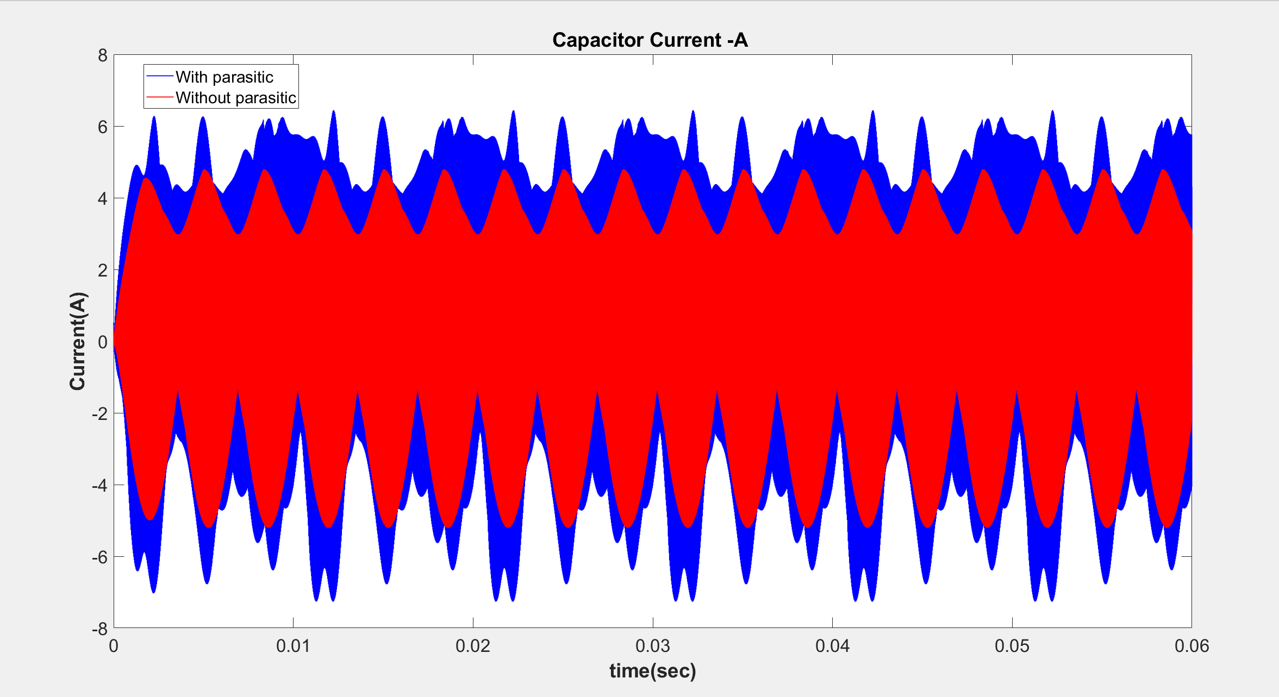

Slide 29
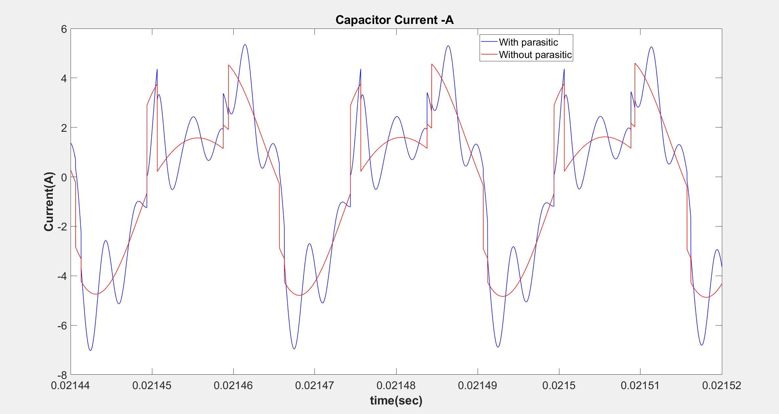

Slide 30
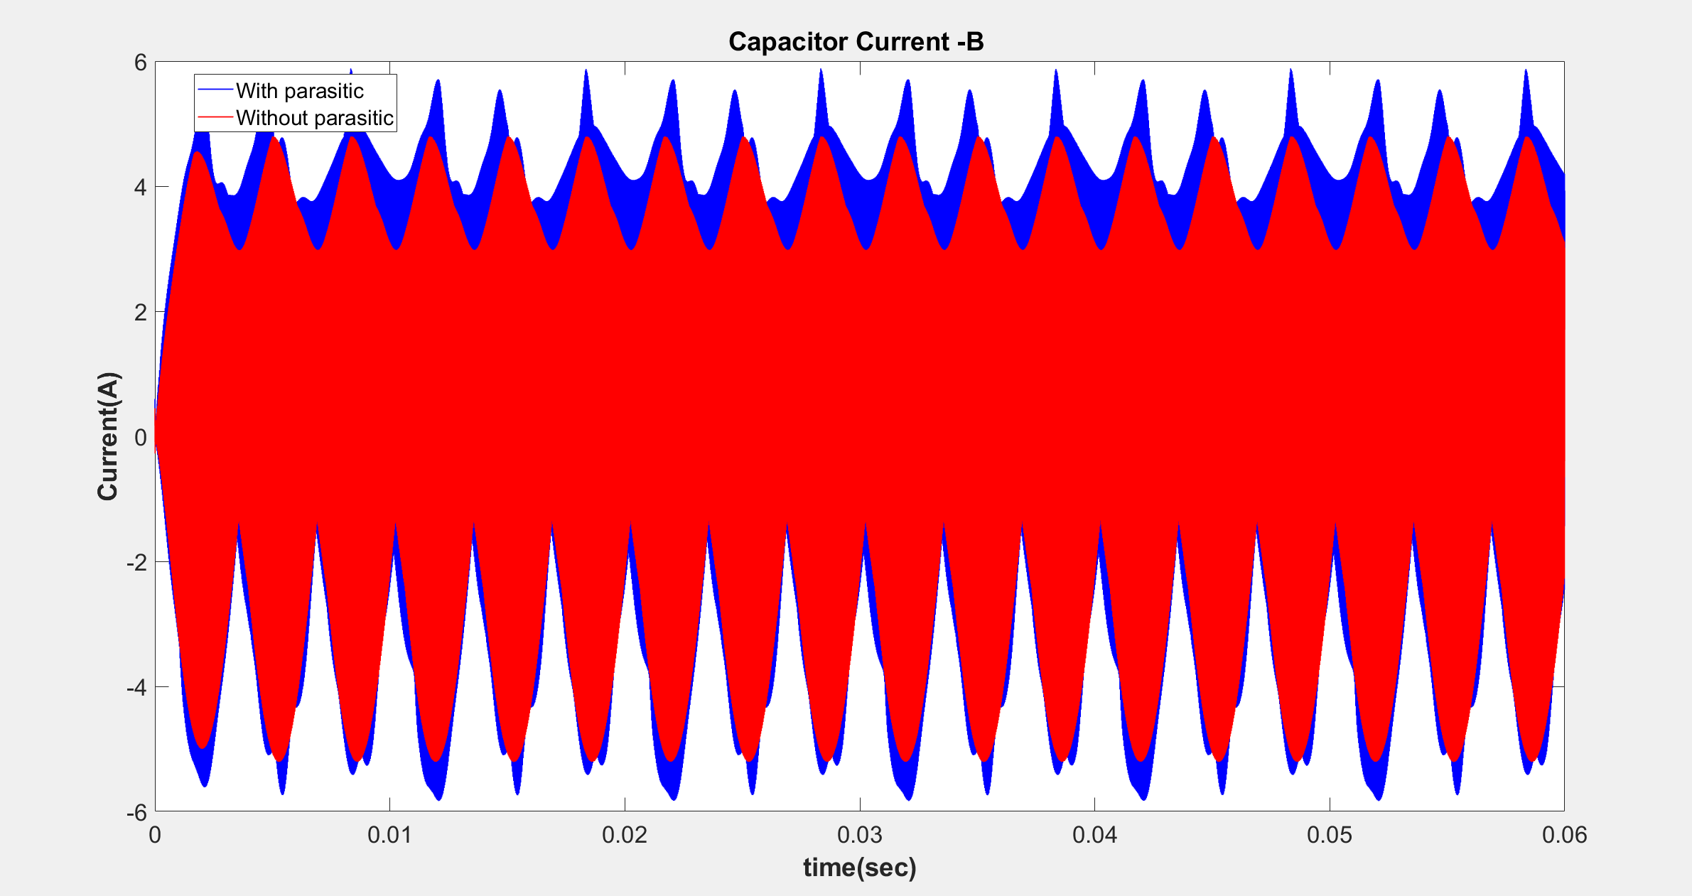

Slide 31
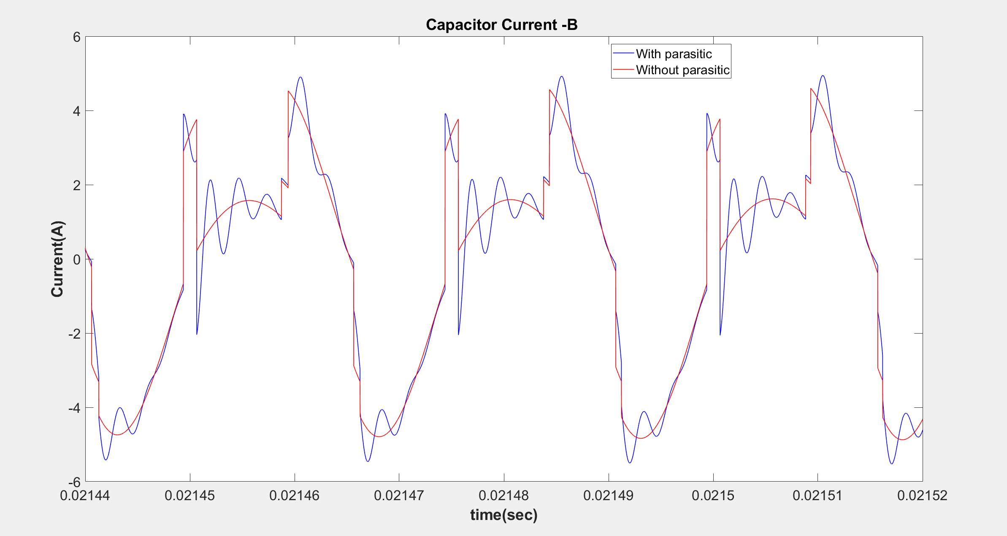

Slide 32
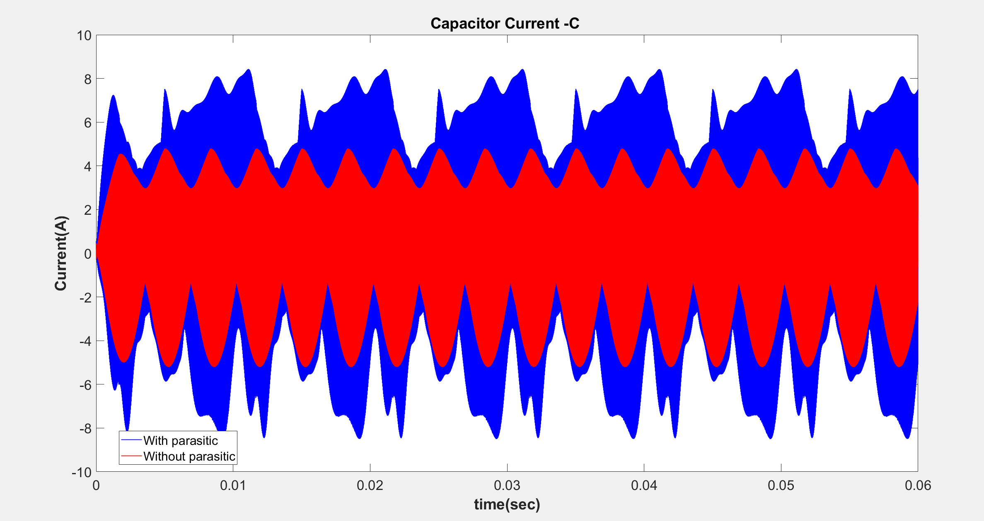

Slide 33
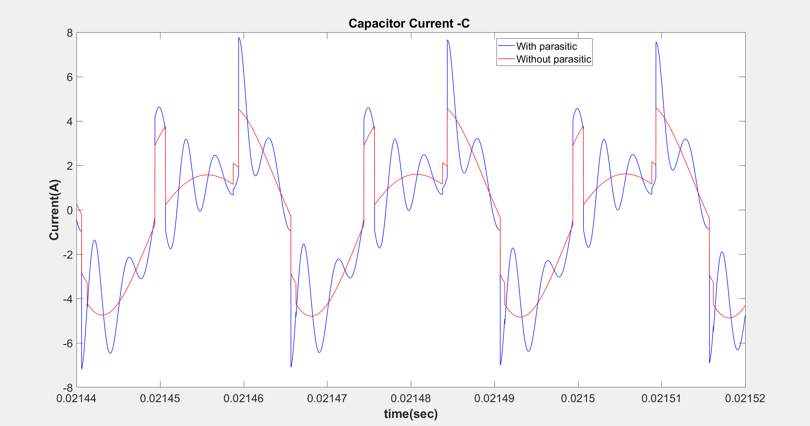

Slide 34
Frequency DOMAIN COMPARISONS
Comparison of input currents
Comparison of leg currents
Comparison of capacitor currents

Slide 35
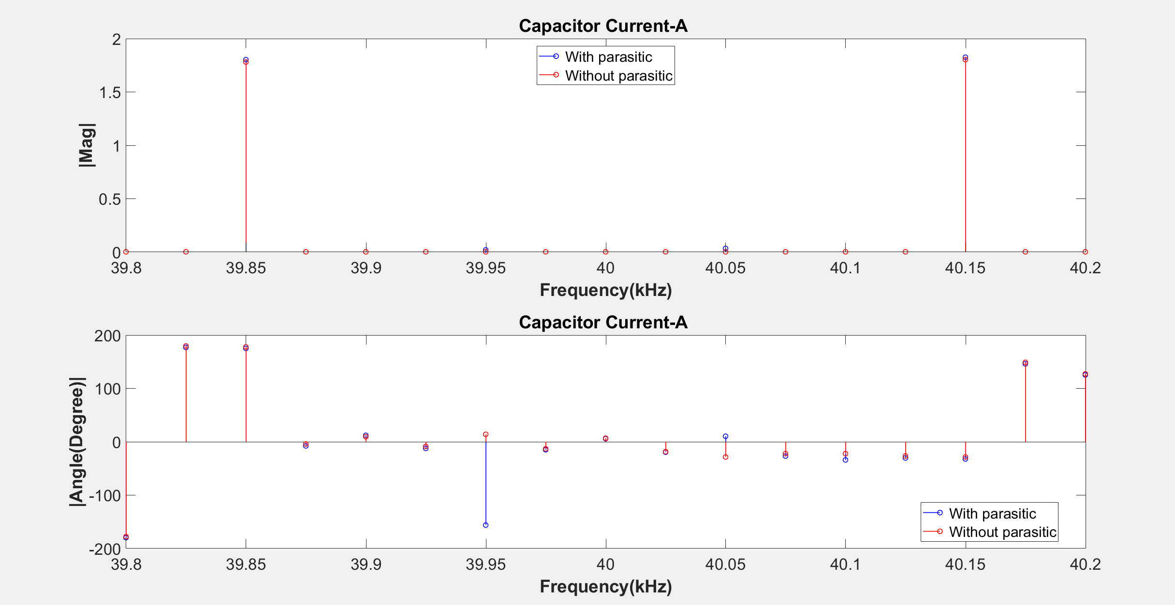

Slide 36
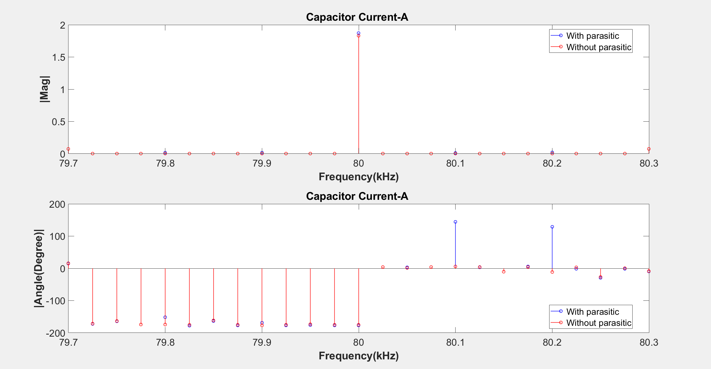

Slide 37
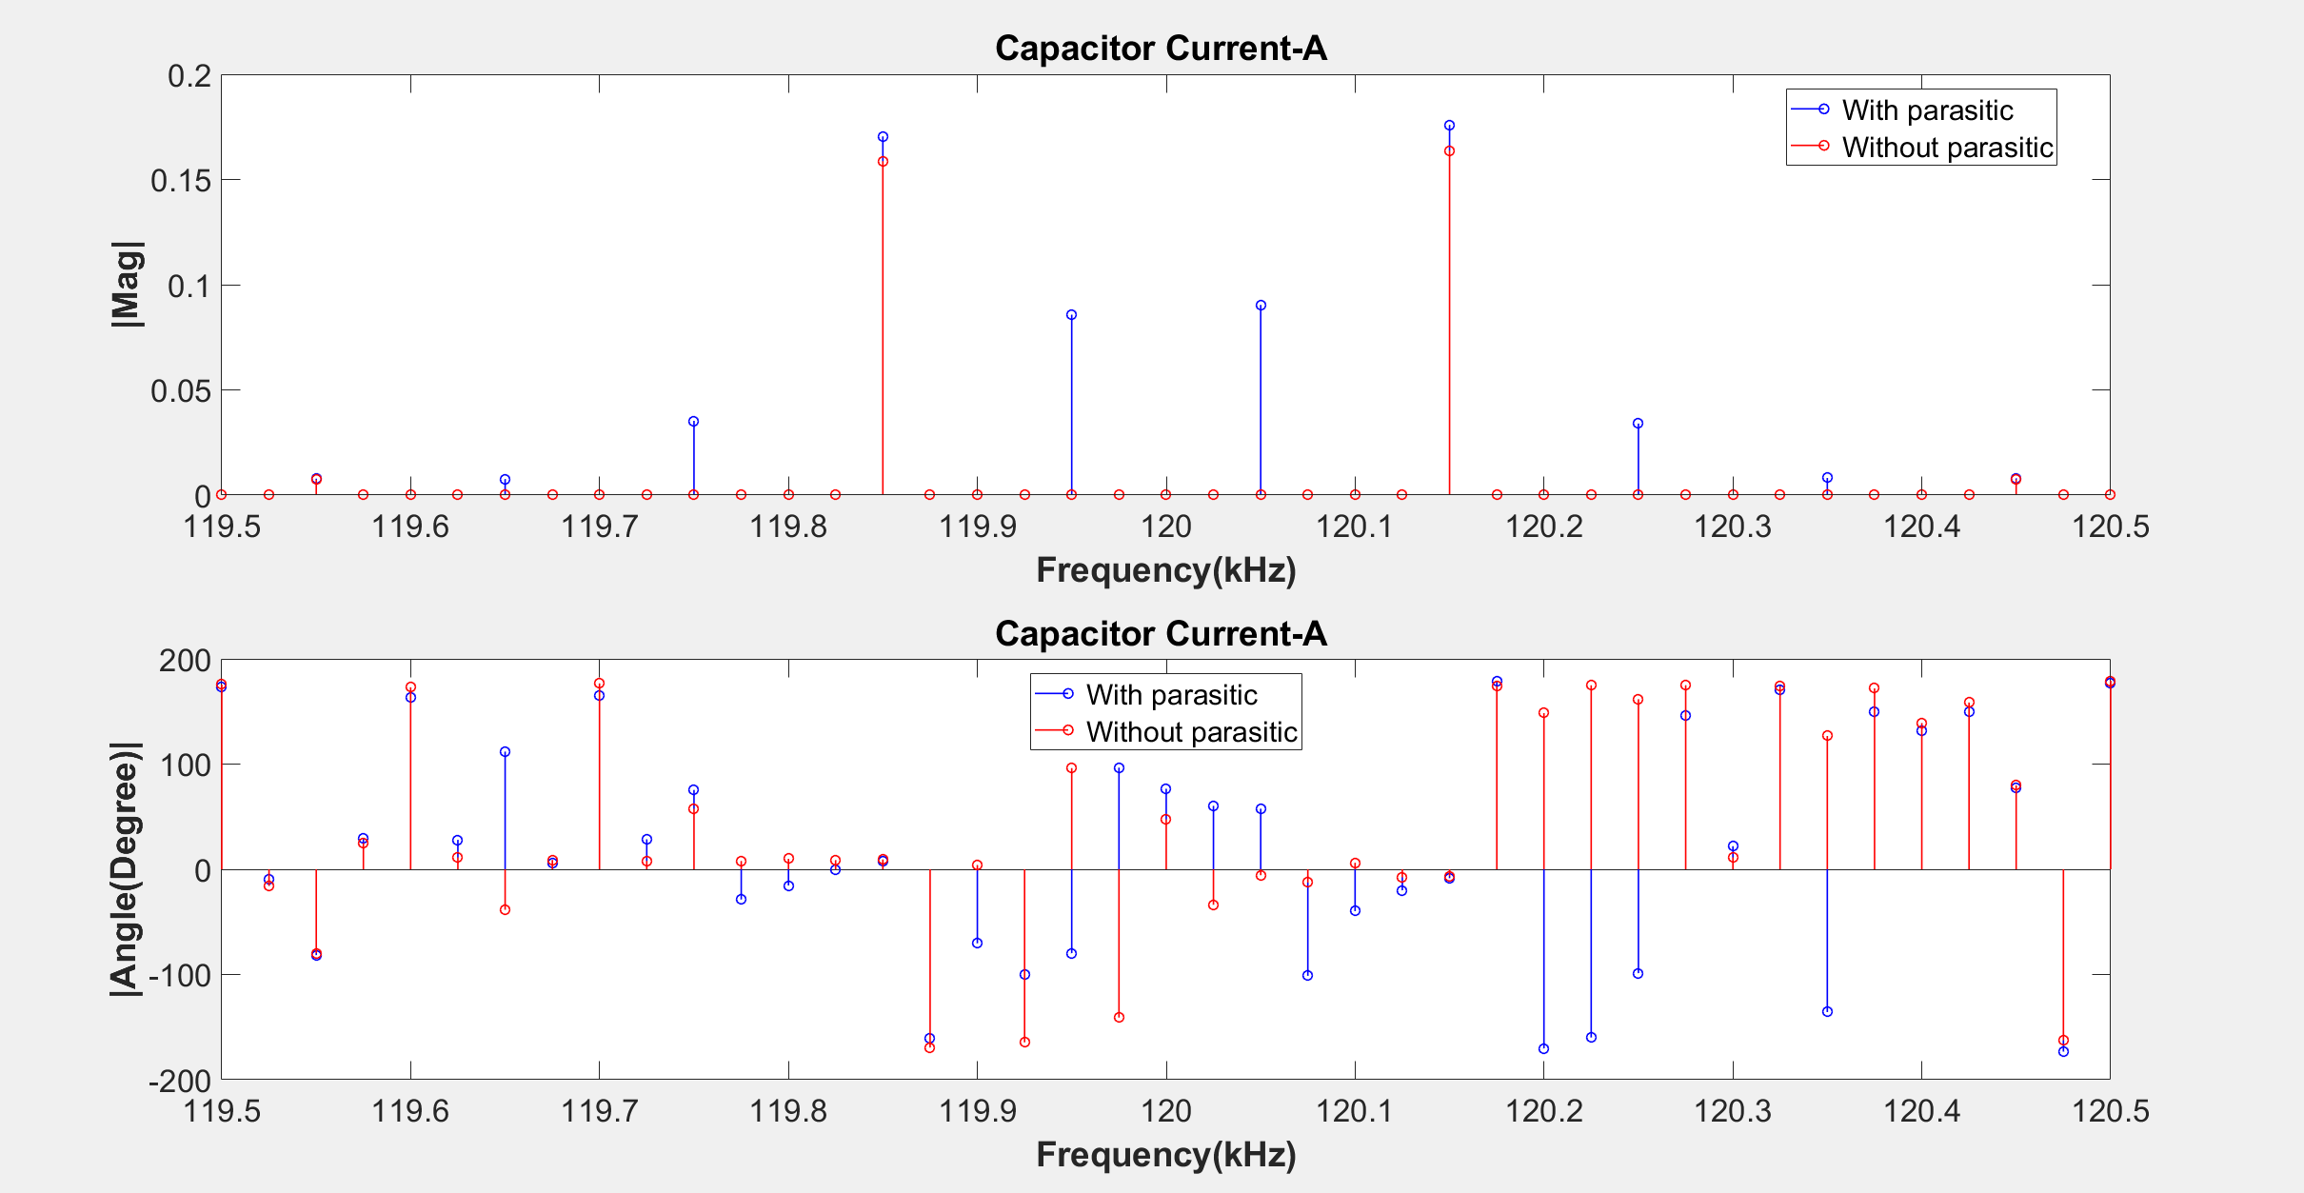

Slide 38
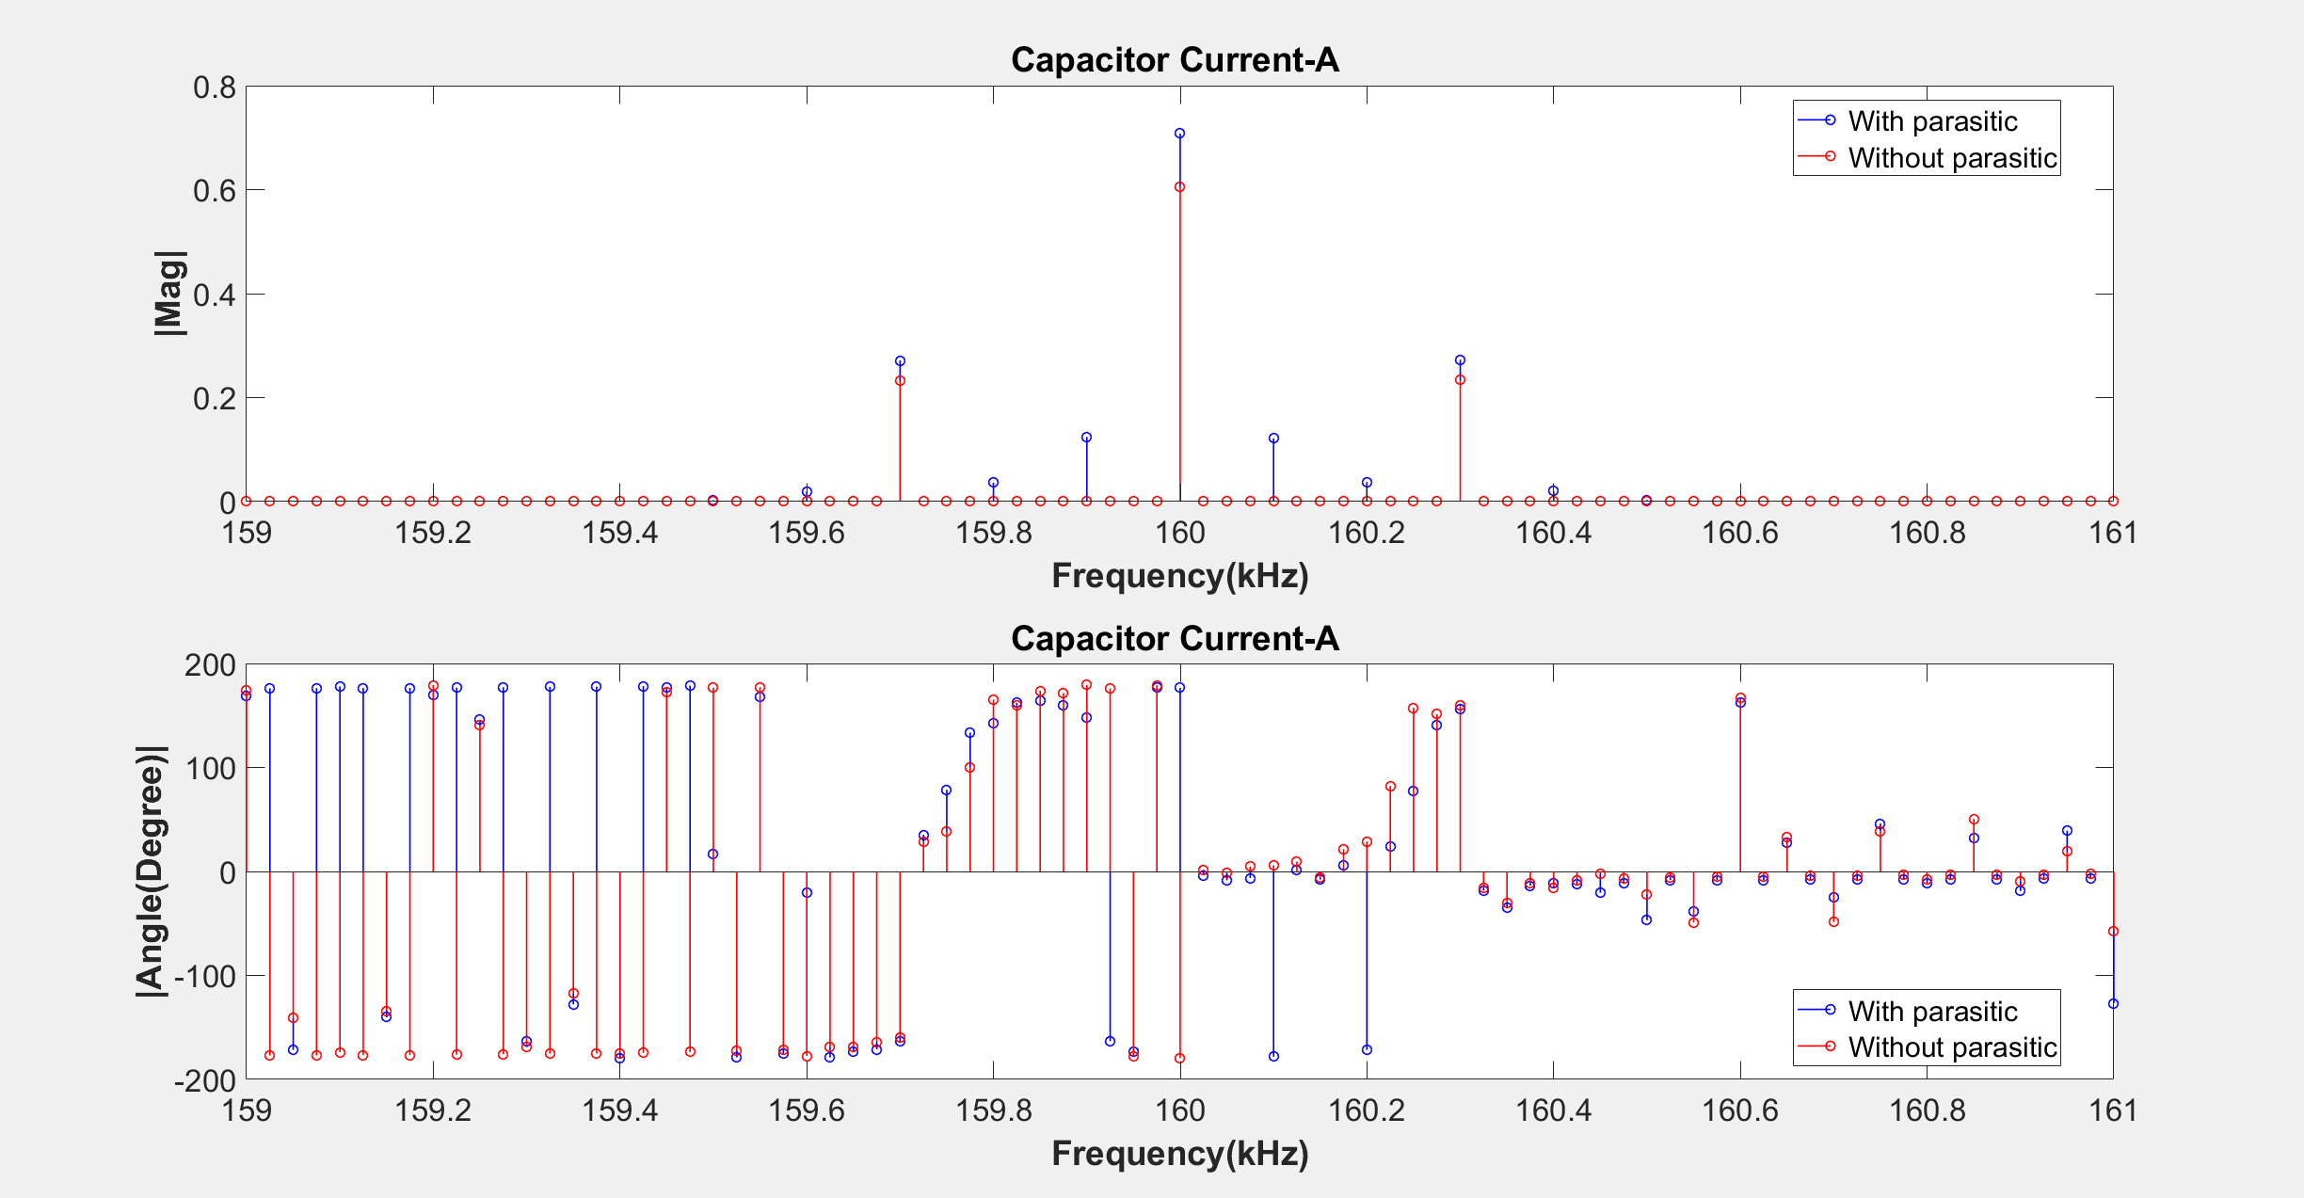

Slide 39
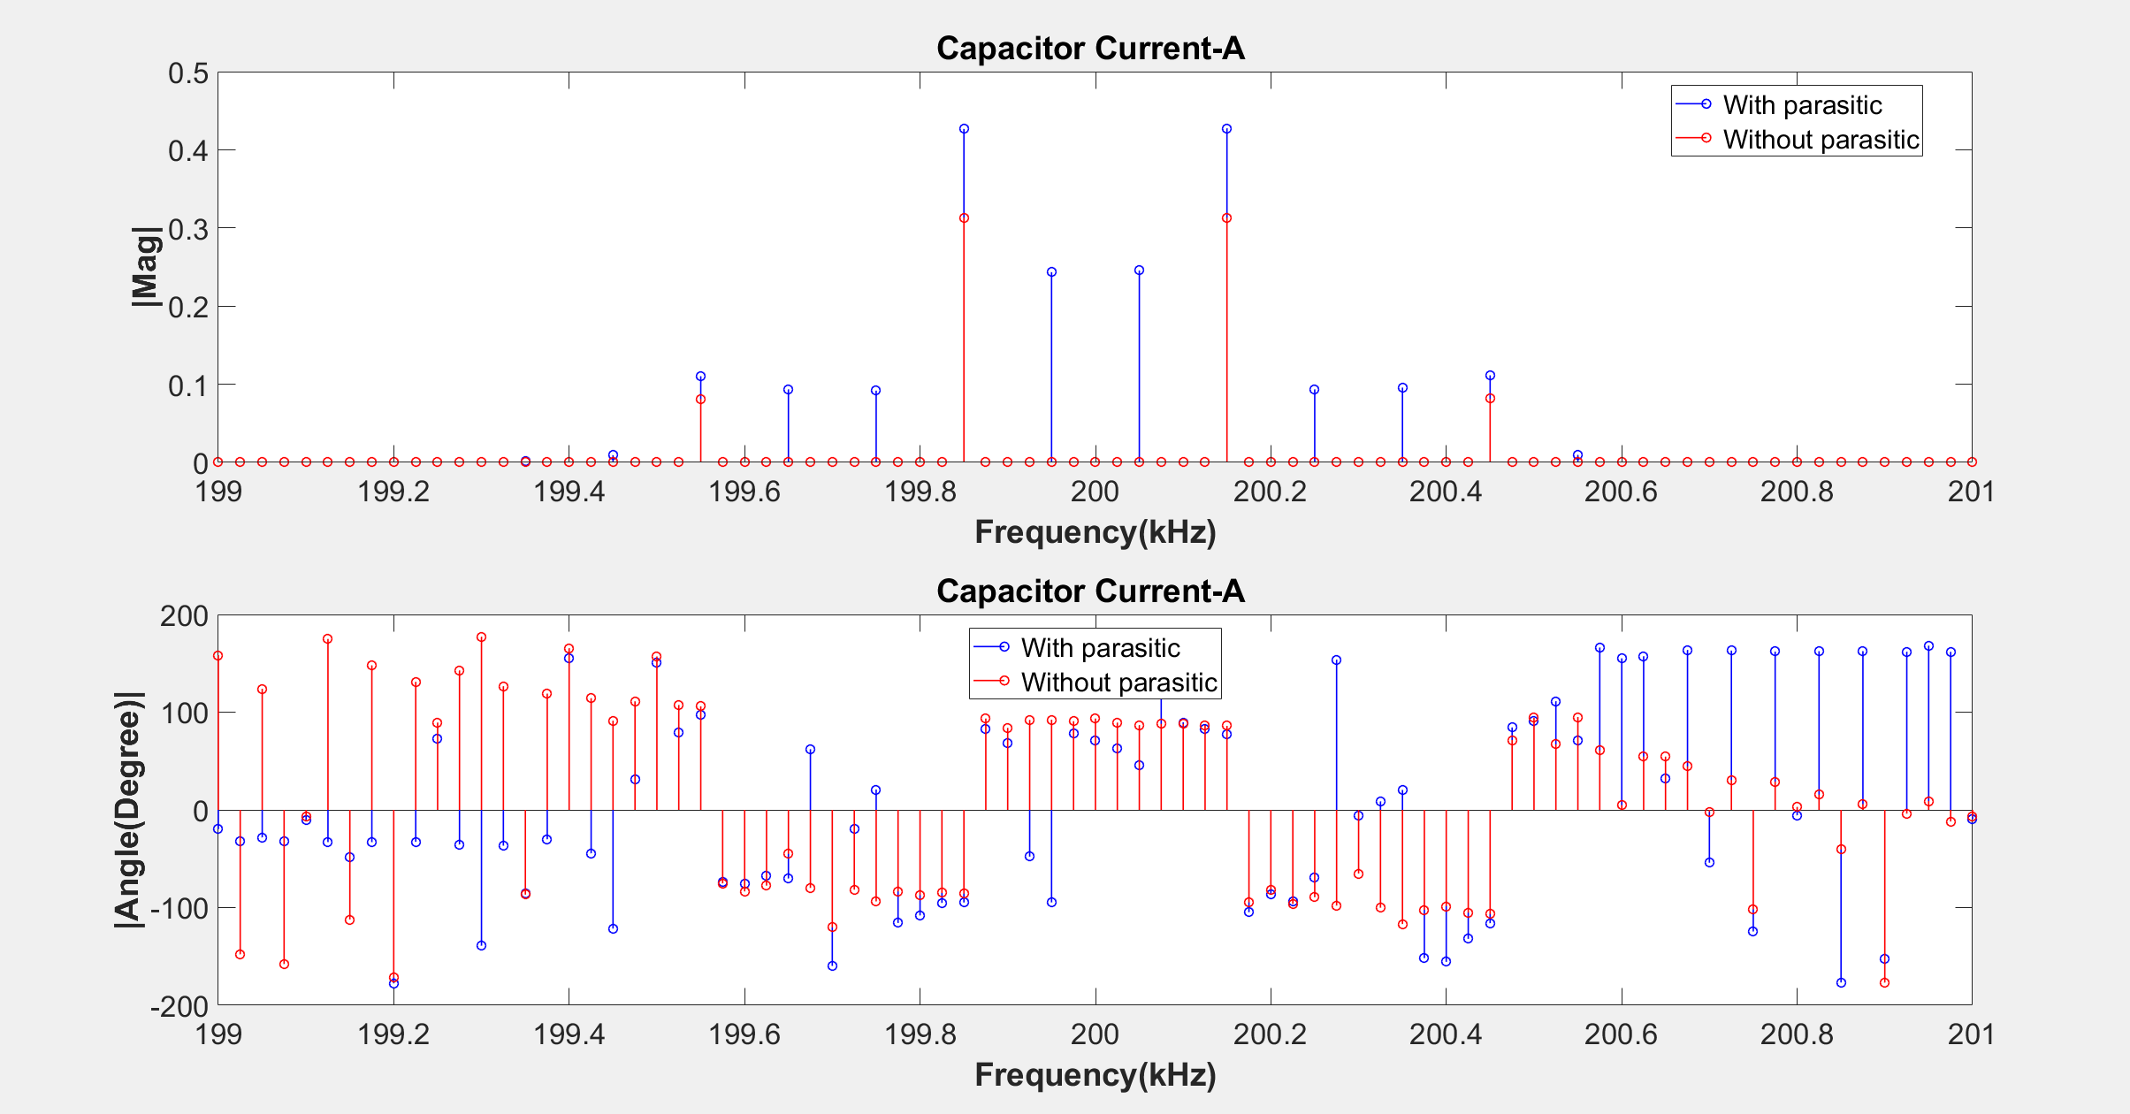

Slide 40
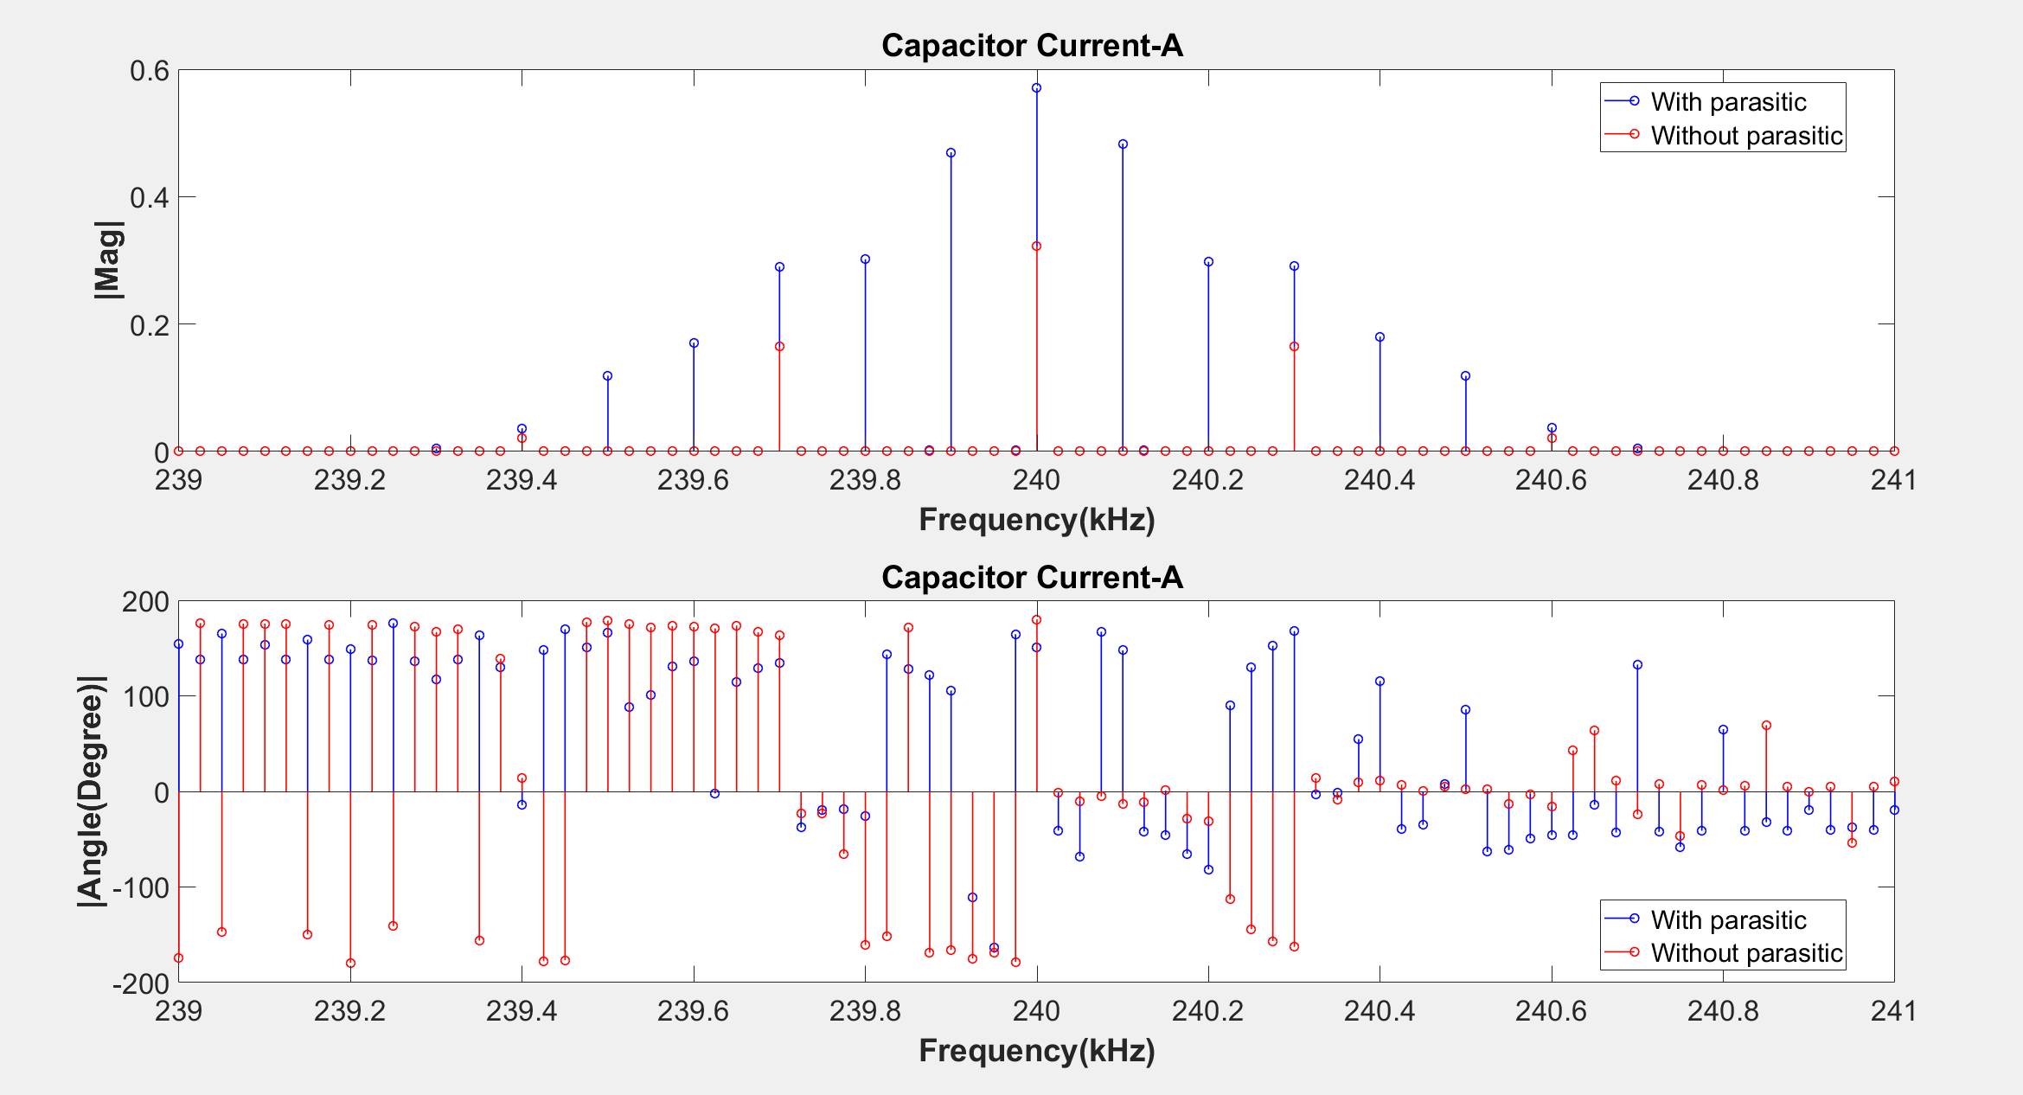

Slide 41
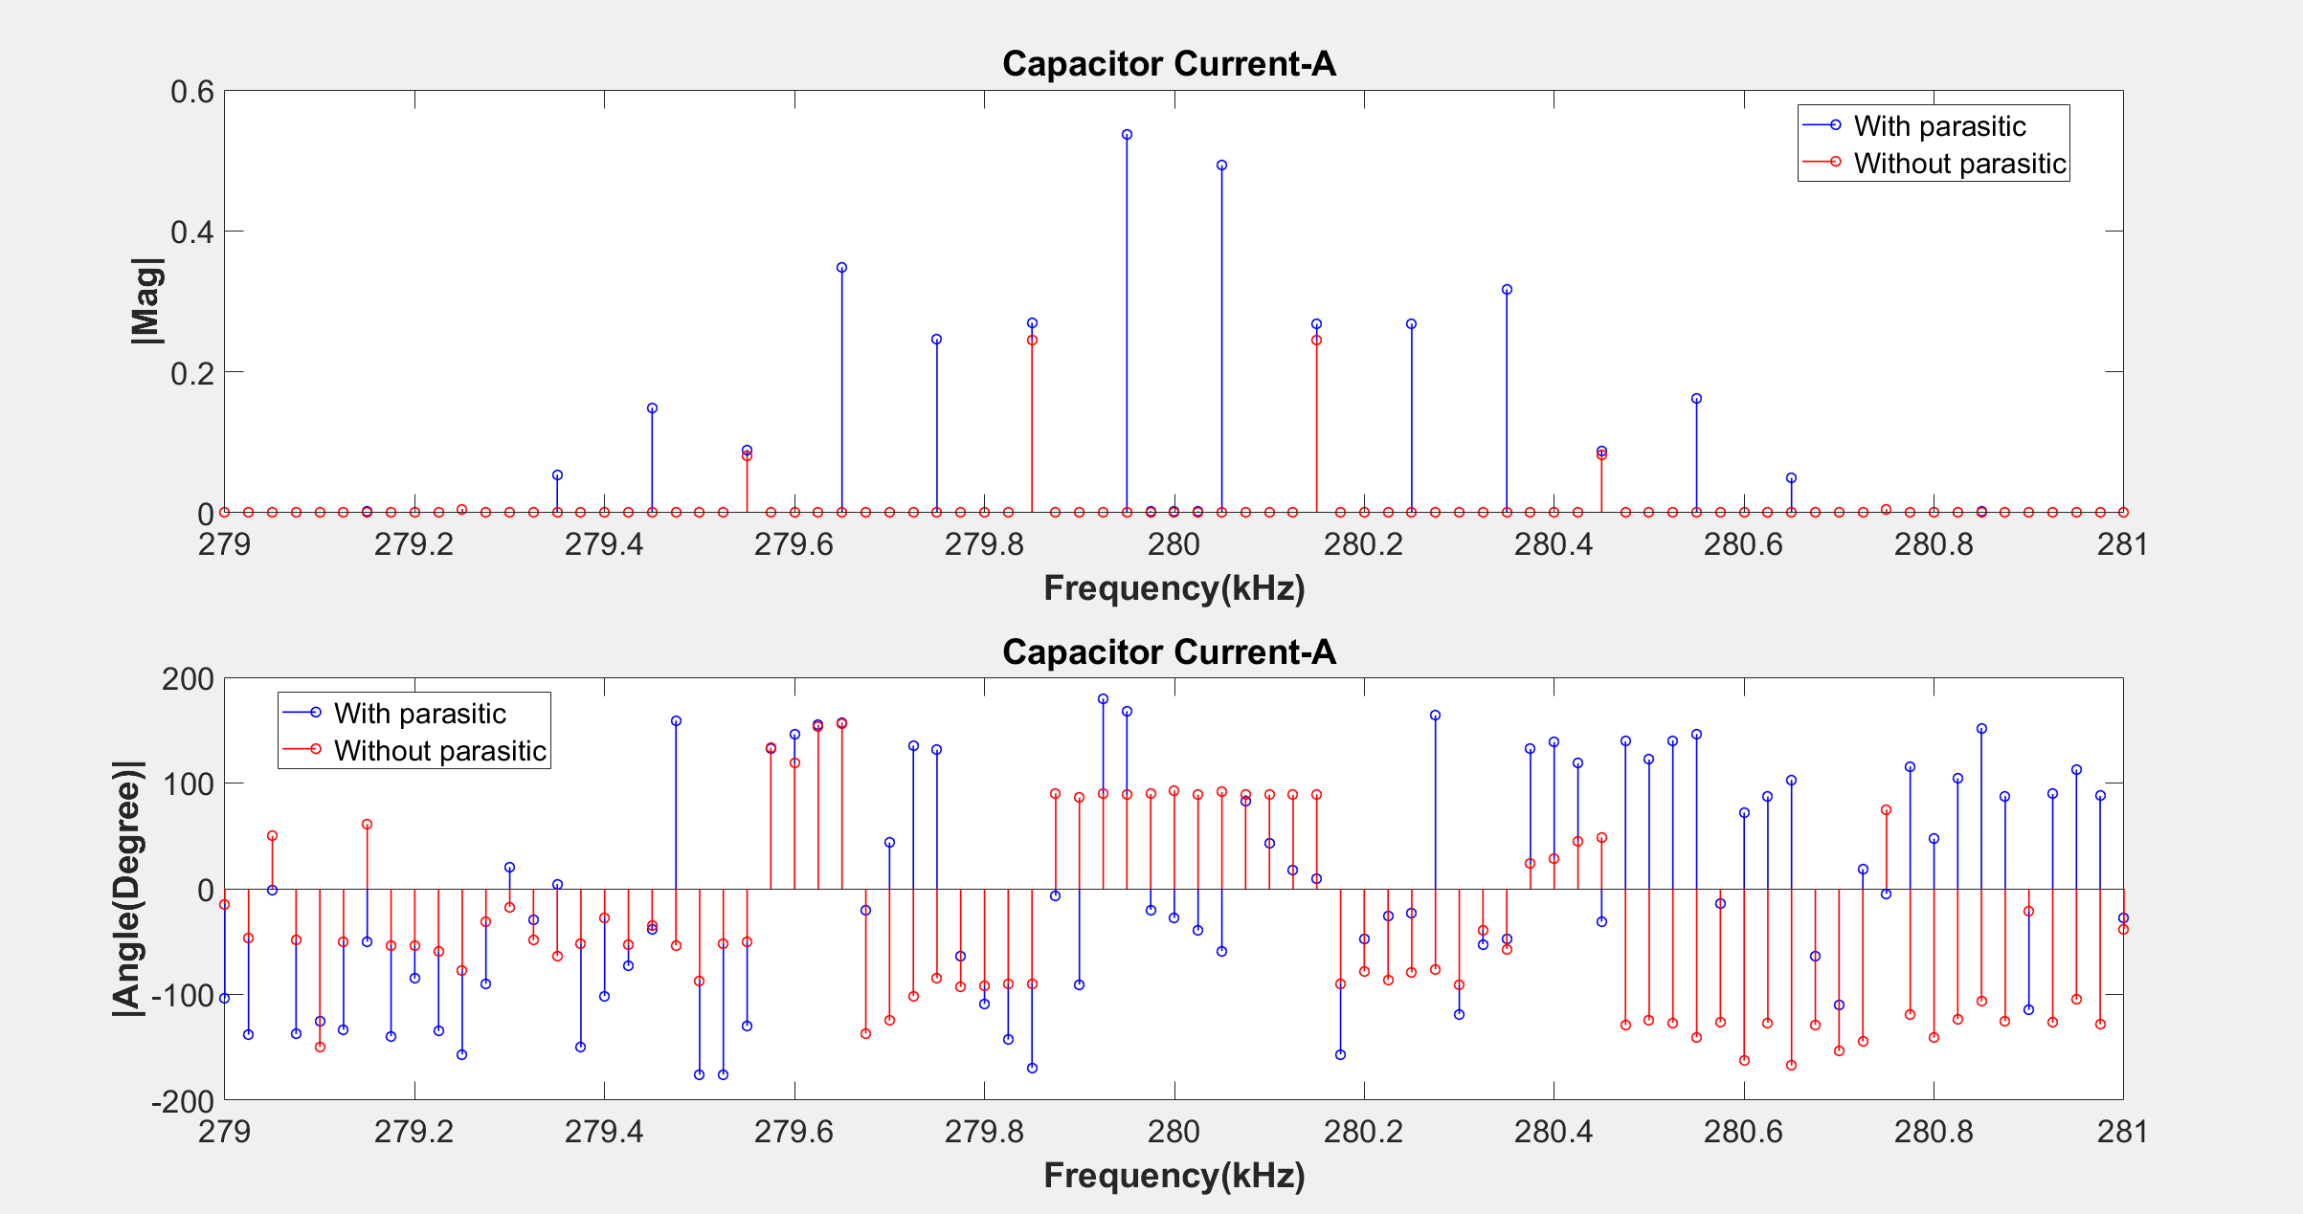

Slide 42
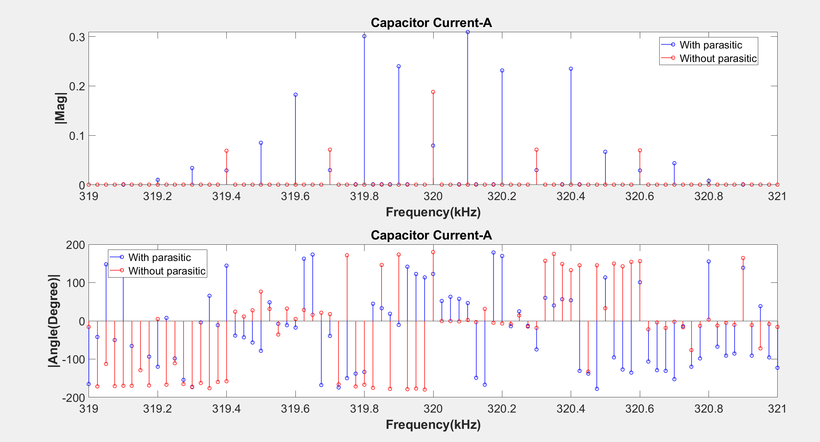

Slide 43
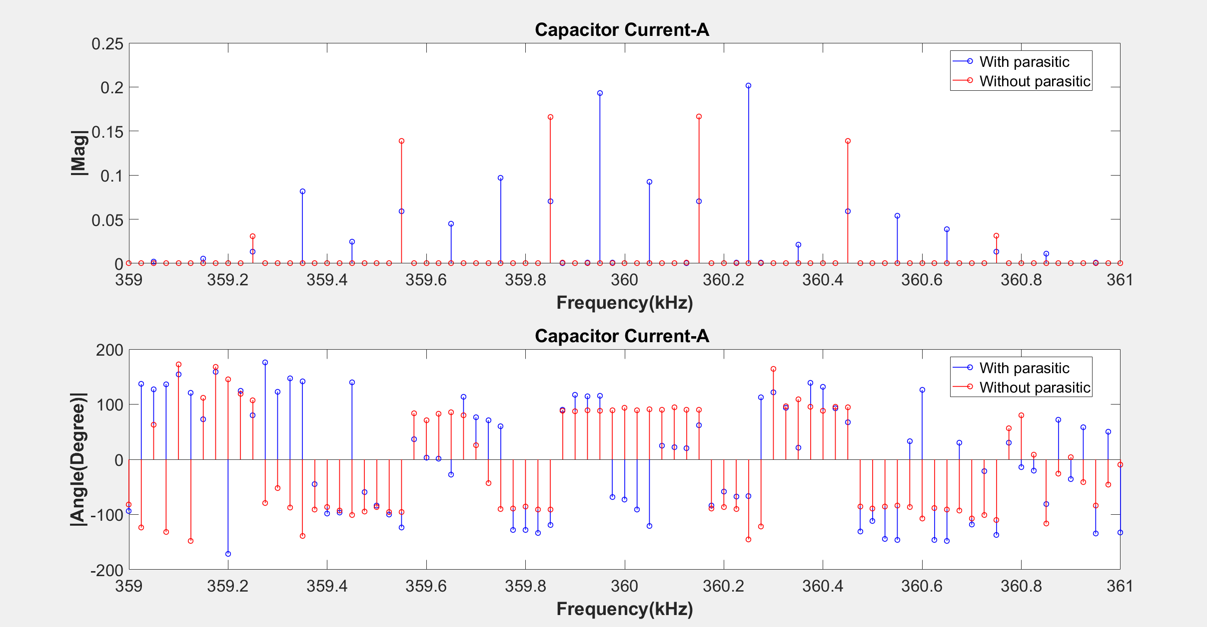

Slide 44
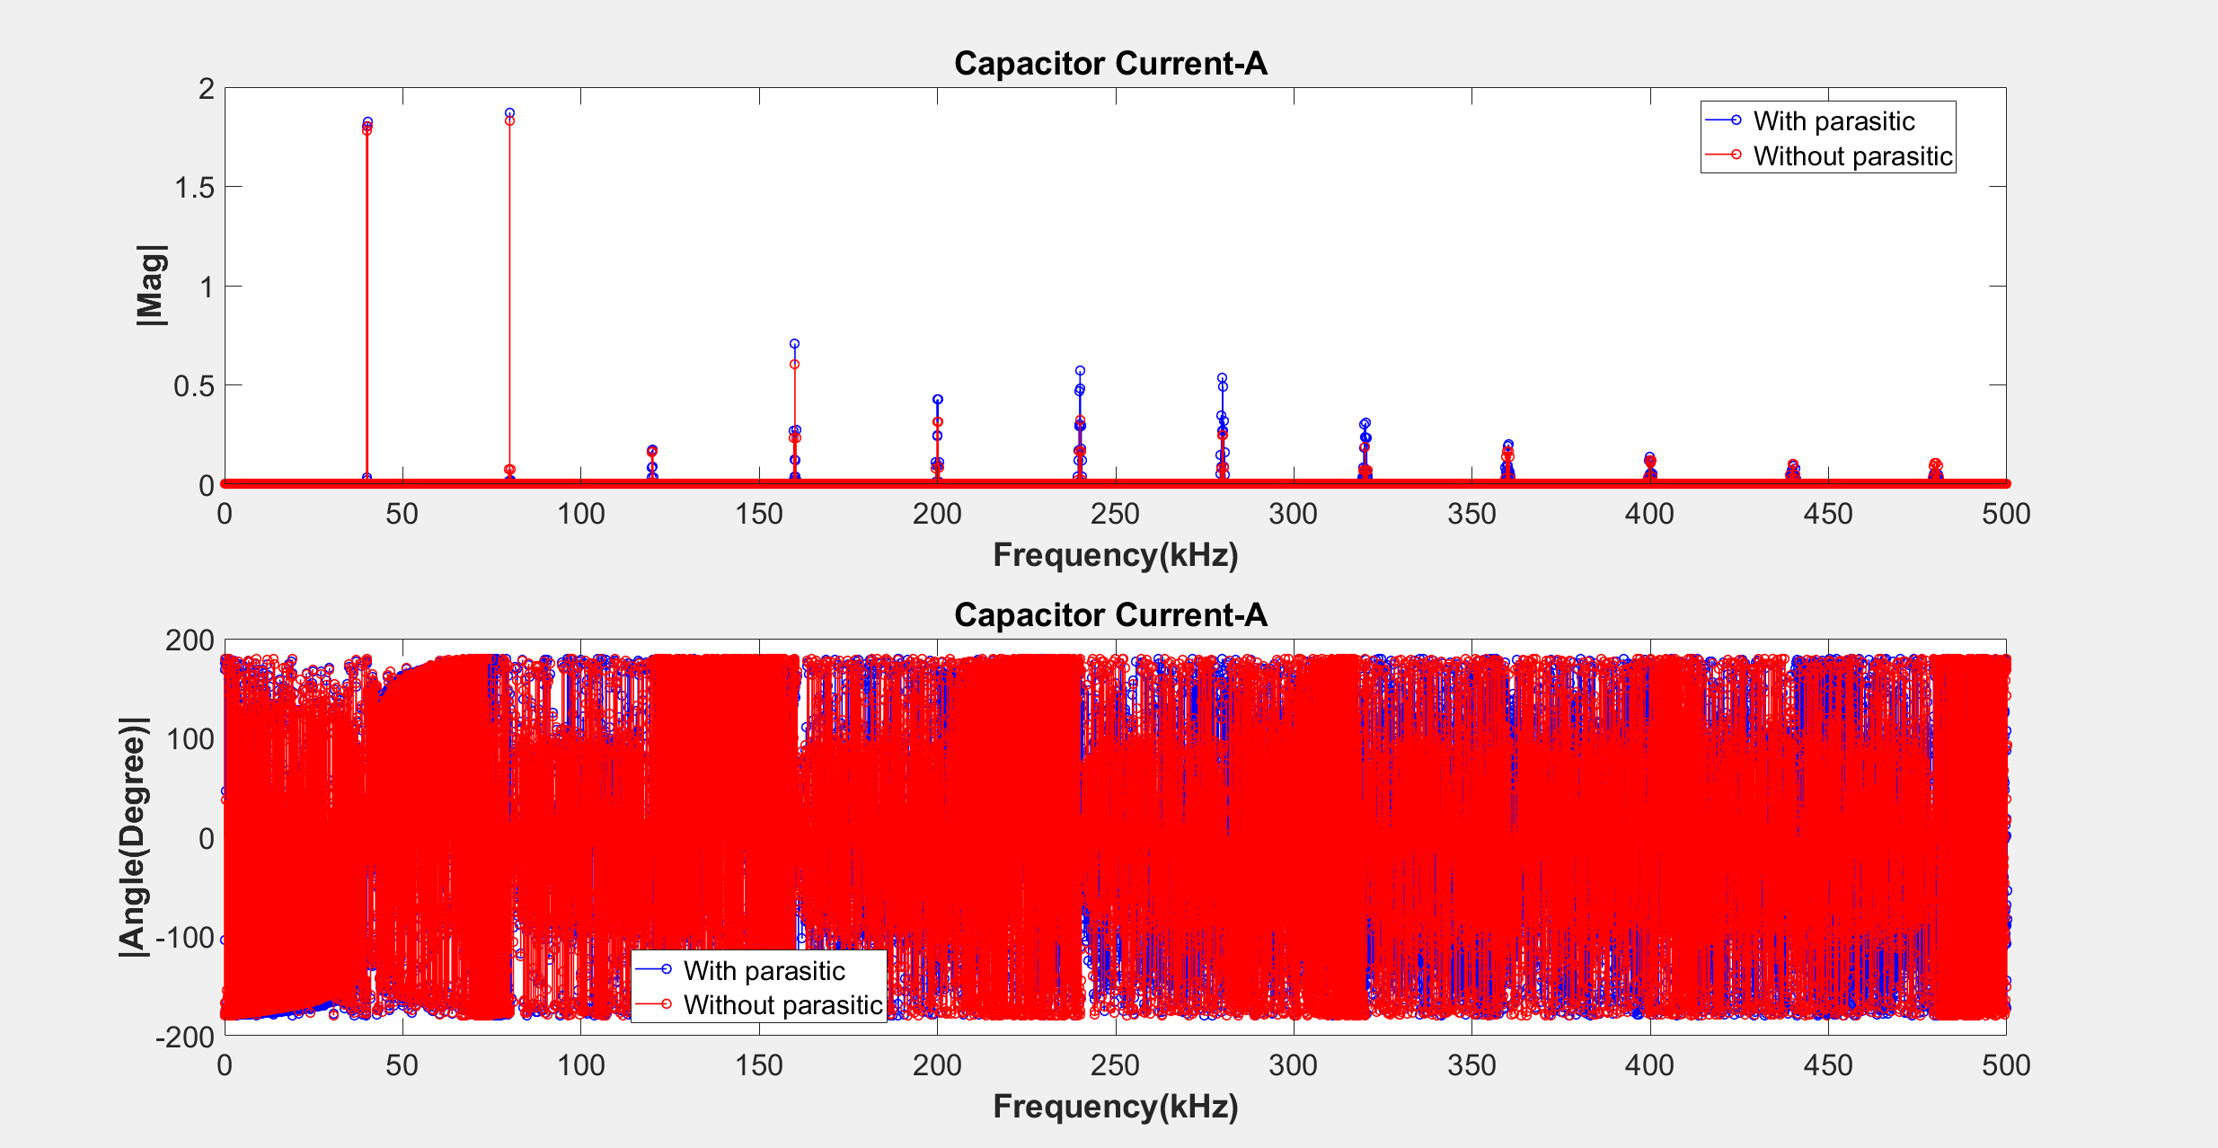

Slide 45
Leg Currents

Slide 46
Frequency (kHz) | phA |Mag| | phB |Mag| | phC |Mag| | phA |Angle| | phB |Angle| | phC |Angle|
119750 | 0.3028 | 0.3032 | 0.3032 | -73.59 | 166.4 | 46.36
119850 | 0.1416 | 0.1413 | 0.1419 | 7.923 | 7.924 | 7.873
159900 | 0.4714 | 0.4715 | 0.4715 | 2.24 | -117.8 | 122.3
199650 | 0.159 | 0.159 | 0.1592 | 114 | -126.1 | -6.034
199750 | 0.1552 | 0.1553 | 0.1554 | -115.3 | 124.8 | 4.701
199950 | 0.4124 | 0.4123 | 0.4123 | 89.73 | -150.3 | -30.21
239500 | 0.07727 | 0.07736 | 0.07734 | 17.4 | 137.4 | -102.7
239600 | 0.1136 | 0.1136 | 01138 | 29.98 | -90.1 | 150
239800 | 0.1952 | 0.1951 | 0.1951 | -173.9 | -53.93 | 66.15
239900 | 0.3105 | 0.3103 | 0.3103 | -0.28 | -120.3 | 119.8

Slide 47
Frequency (kHz) | phA |Mag| | phB |Mag| | phC |Mag| | phA |Angle| | phB |Angle| | phC |Angle|
279450 | 0.07363 | 0.07375 | 0.07372 | -70.7 | 169.3 | 49.17
279650 | 0.1579 | 0.1579 | 0.1578 | 77.82 | -162.2 | -42.21
279750 | 0.122 | 0.1222 | 0.1221 | 100 | -20.02 | -140
279950 | 0.2447 | 0.2444 | 0.2444 | 89.24 | -150.8 | -30.66
319500 | 0.05395 | 0.05395 | 0.05406 | -124.9 | -4.9 | 115
319600 | 0.1497 | 0.1497 | 0.1496 | -8.574 | -128.6 | 111.4
319800 | 01913 | 0.1913 | 0.1913 | -179.6 | -59.64 | 60.41
319900 | 01975 | 0.1972 | 0.1971 | -1.183 | -121.3 | 118.9

Slide 48
Impedance Model

Slide 49
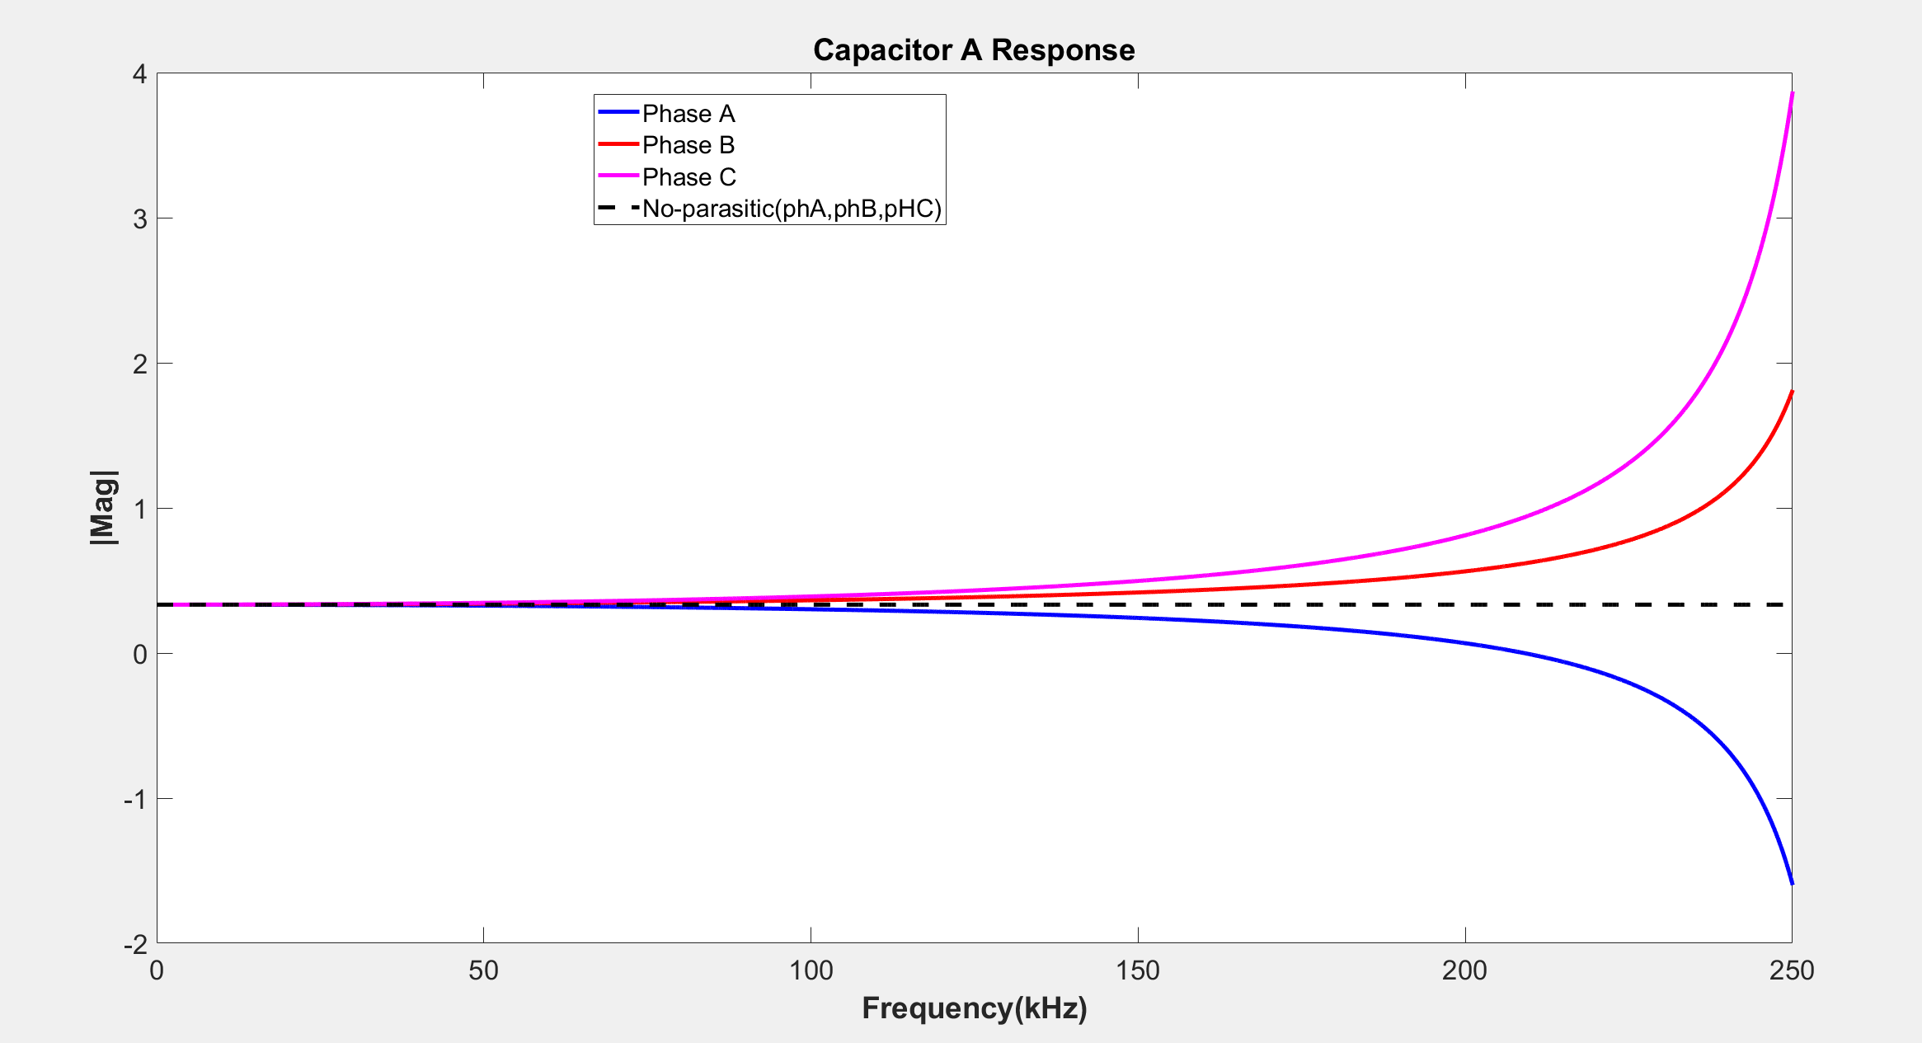

Slide 50
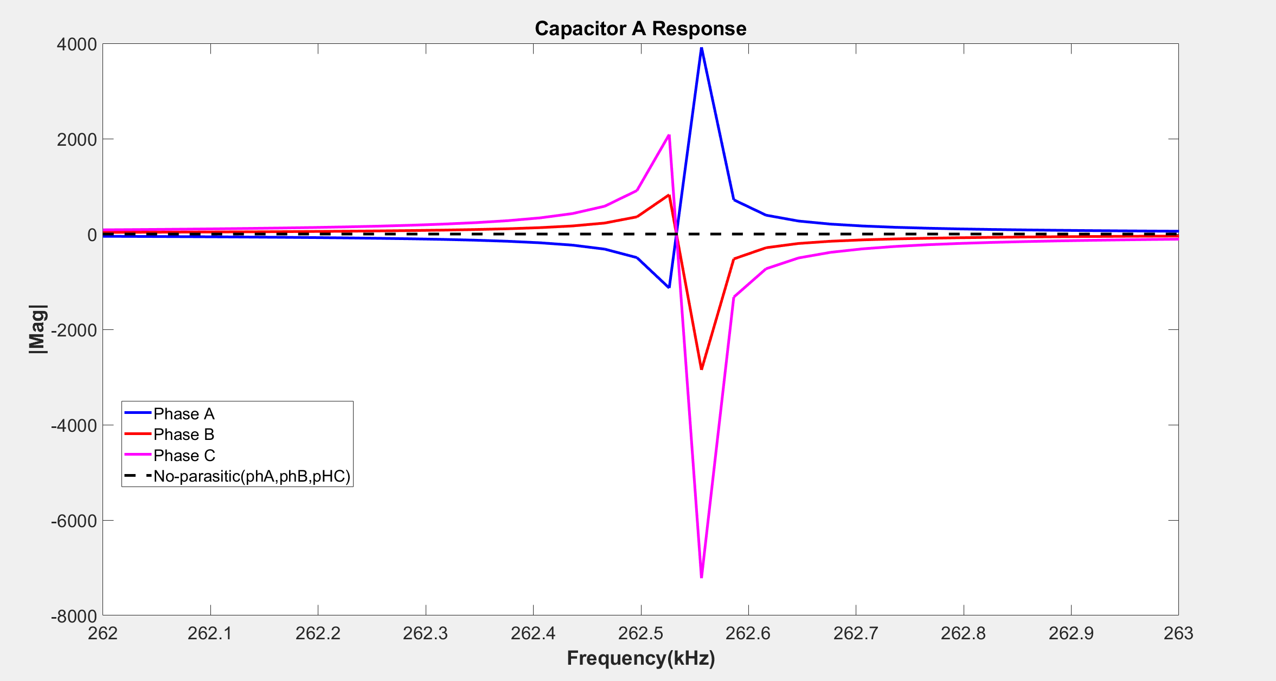

Slide 51
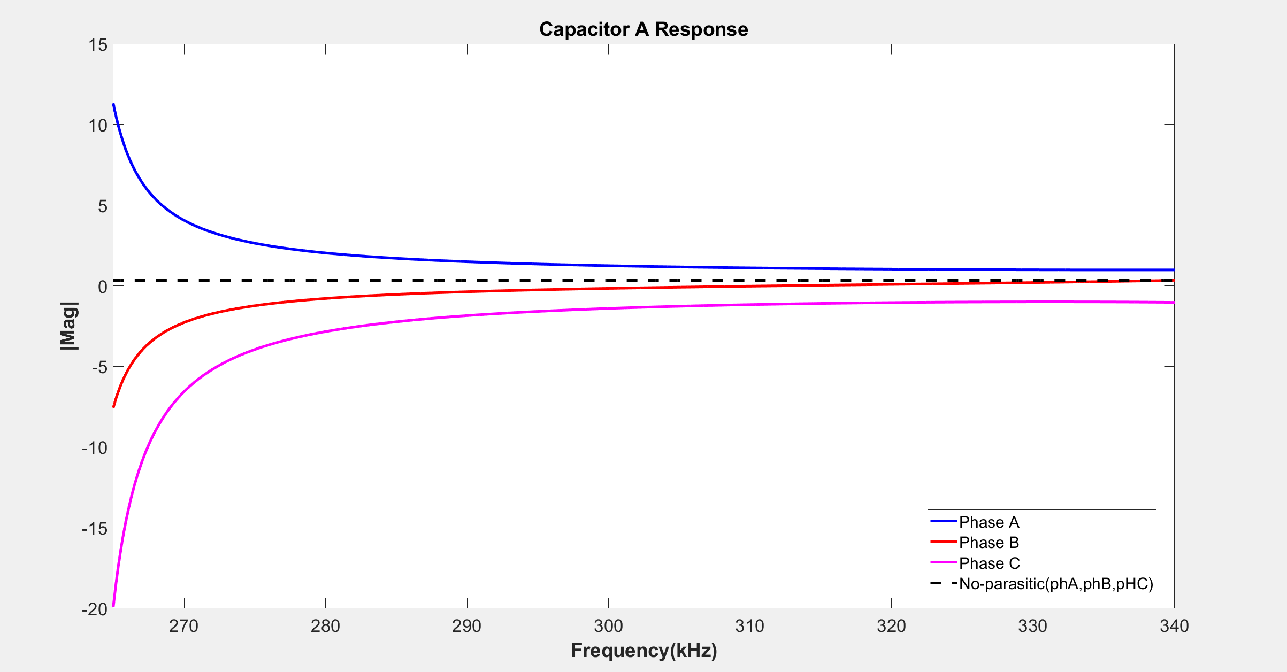

Slide 52
Frequency (kHz) | sA |Mag| | sB |Mag| | sC |Mag| | phA |Mag| | phB |Mag| | phC |Mag|
119750 | 0.3028 | 0.3032 | 0.3032 | 0.2839 | 0.3795 | 0.4211
119850 | 0.1416 | 0.1413 | 0.1419 | 0.2838 | 0.3796 | 0.4212
159900 | 0.4714 | 0.4715 | 0.4715 | 0.2214 | 0.4348 | 0.5329
199650 | 0.159 | 0.159 | 0.1592 | 0.0696 | 0.5611 | 0.8074
199750 | 0.1552 | 0.1553 | 0.1554 | 0.0689 | 0.5616 | 0.8086
199950 | 0.4124 | 0.4123 | 0.4123 | 0.0677 | 0.5626 | 0.8109
239500 | 0.07727 | 0.07736 | 0.07734 | -0.6418 | 1.1057 | 2.1092
239600 | 0.1136 | 0.1136 | 01138 | -0.6467 | 1.1094 | 2.1182
239800 | 0.1952 | 0.1951 | 0.1951 | -0.6567 | 1.1169 | 2.1367
239900 | 0.3105 | 0.3103 | 0.3103 | -0.6618 | 1.1206 | 2.1460

Slide 53
Frequency (kHz) | sA |Mag| | sB |Mag| | sC |Mag| | phA |Mag| | phB |Mag| | phC |Mag|
279450 | 0.07363 | 0.07375 | 0.07372 | 2.0831 | -0.8234 | -2.9298
279650 | 0.1579 | 0.1579 | 0.1578 | 2.0650 | -0.8099 | -2.8965
279750 | 0.122 | 0.1222 | 0.1221 | 2.0561 | -0.8032 | -2.8802
279950 | 0.2447 | 0.2444 | 0.2444 | 2.0386 | -0.7901 | -2.8482
319500 | 0.05395 | 0.05395 | 0.05406 | 1.0351 | 0.0803 | -1.0459
319600 | 0.1497 | 0.1497 | 0.1496 | 1.0345 | 0.0814 | -1.0450
319800 | 0.1913 | 0.1913 | 0.1913 | 1.0334 | 0.0835 | -1.0432
319900 | 0.1975 | 0.1972 | 0.1971 | 1.0328 | 0.0846 | -1.0424

Slide 54
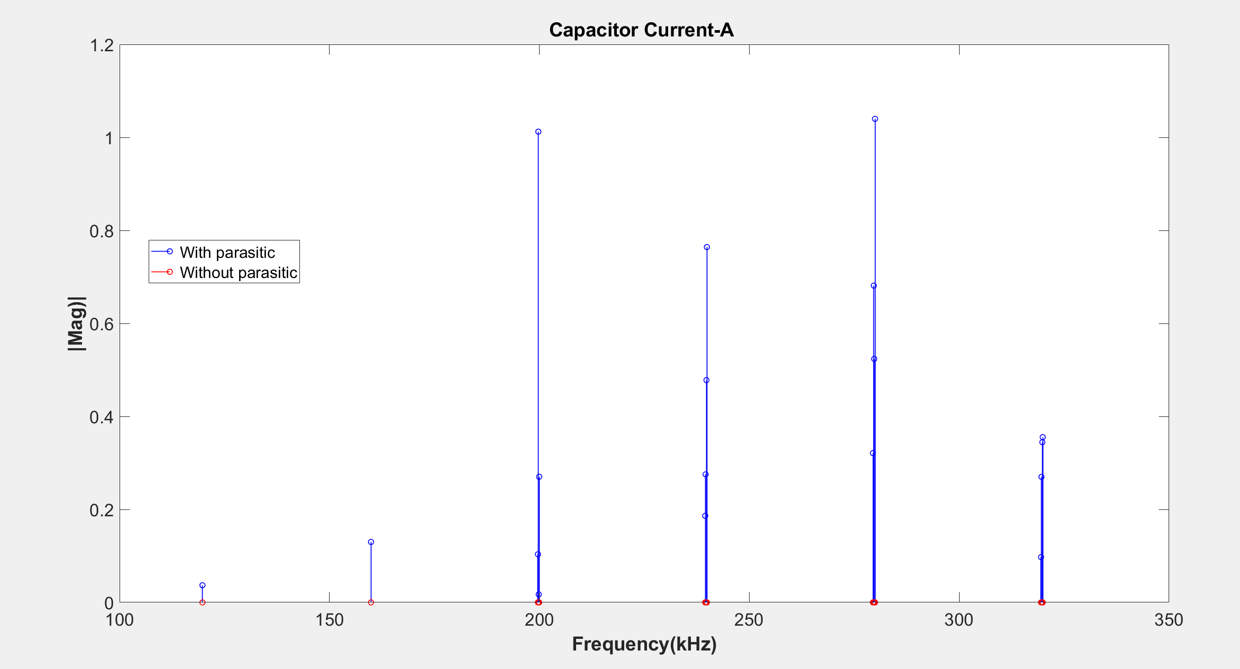

Slide 55
CONCLUSION
Although the impedance model can be wrong, the FFT results of with and without parasitic components show that the some side-bands amplify due to unbalanced three phase.
However, the amplification does not depend on resonance frequency of the system.
The switching frequency was adjusted by considering the resonance frequency (sw,tch,ng frequency is one of six resonance frequency) and we did not observe amplifications. However, it stems from wrong impedance model

Slide 57
Frequency (kHz) | phA |Mag| | phB |Mag| | phC |Mag| | phA |Angle| | phB |Angle| | phC |Angle|
39850 | 0.3289 | 0.3376 | 0.3411
40150 | 0.3289 | 0.3376 | 0.3412
80000 | 0.3142 | 0.3516 | 0.3672
119750 | 0.2839 | 0.3795 | 0.4211
119850 | 0.2838 | 0.3796 | 0.4212
119950 | 0.2837 | 0.3797 | 0.4214
120050 | 0.2836 | 0.3798 | 0.4216
120150 | 0.2835 | 0.3799 | 0.4218
120250 | 0.2834 | 0.3800 | 0.4220

Slide 58
Frequency (kHz) | phA |Mag| | phB |Mag| | phC |Mag| | phA |Angle| | phB |Angle| | phC |Angle|
159700 | 0.2219 | 0.4344 | 0.5321
159800 | 0.2216 | 0.4346 | 0.5325
159900 | 0.2214 | 0.4348 | 0.5329
160000 | 0.2212 | 0.4350 | 0.5333
160100 | 0.2210 | 0.4352 | 0.5337
160200 | 0.2207 | 0.4354 | 0.5341
160300 | 0.2205 | 0.4356 | 0.5345

Slide 59
Frequency (kHz) | phA |Mag| | phB |Mag| | phC |Mag| | phA |Angle| | phB |Angle| | phC |Angle|
199550 | 0.0702 | 0.5605 | 0.8062
199650 | 0.0696 | 0.5611 | 0.8074
199750 | 0.0689 | 0.5616 | 0.8086
199850 | 0.0683 | 0.5621 | 0.8097
199950 | 0.0677 | 0.5626 | 0.8109
200050 | 0.0670 | 0.5631 | 0.8121
200150 | 0.0664 | 0.5637 | 0.8132
200250 | 0.0657 | 0.5642 | 0.8144
200350 | 0.0651 | 0.5647 | 0.8156
200450 | 0.0644 | 0.5652 | 0.8168
200550 | 0.0638 | 0.5658 | 0.8180

Slide 60
Frequency (kHz) | phA |Mag| | phB |Mag| | phC |Mag| | phA |Angle| | phB |Angle| | phC |Angle|
239400 | -0.6369 | 1.1020 | 2.1002
239500 | -0.6418 | 1.1057 | 2.1092
239600 | -0.6467 | 1.1094 | 2.1182
239700 | -0.6517 | 1.1131 | 2.1274
239800 | -0.6567 | 1.1169 | 2.1367
239900 | -0.6618 | 1.1206 | 2.1460
240000 | -0.6669 | 1.1245 | 2.1554
240100 | -0.6721 | 1.1283 | 2.1649
240200 | -0.6773 | 1.1322 | 2.1745
240300 | -0.6826 | 1.1361 | 2.1841
240400 | -0.6879 | 1.1401 | 2.1939
240500 | -0.6932 | 1.1441 | 2.2037
240600 | -0.6986 | 1.1481 | 2.2136

